Slide 1
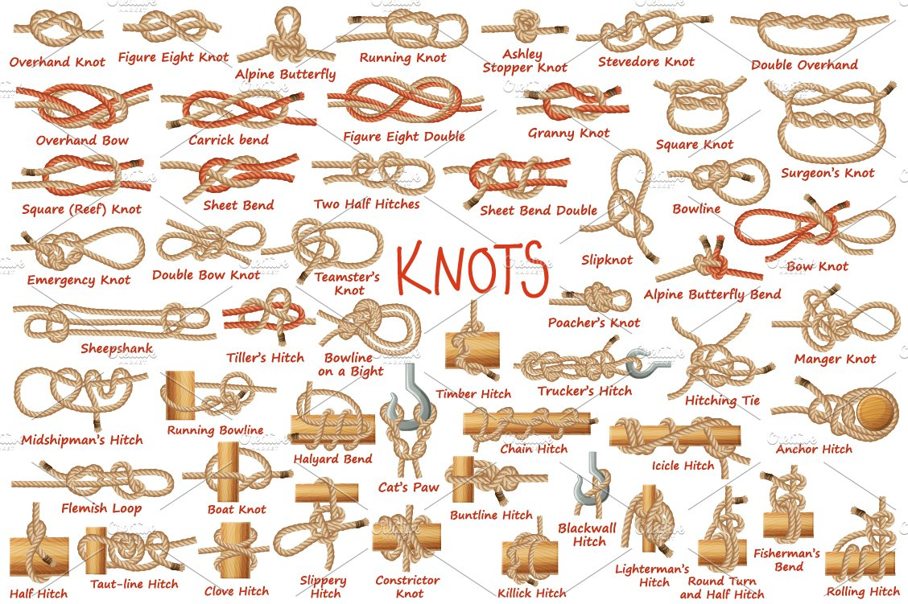
Troop 648 Knot Tying Tutorial

Slide 2
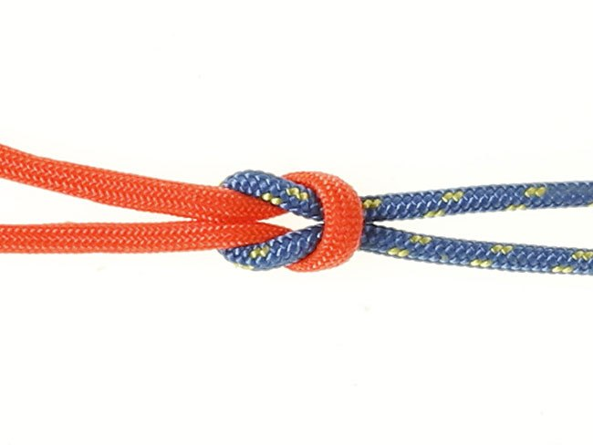
Square Knot

Slide 3
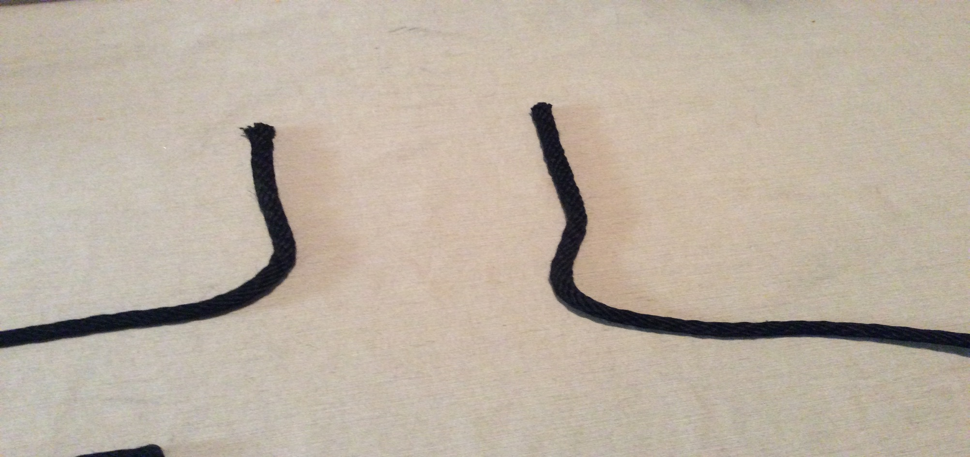
Step 1. hold both ropes in hand or set on a table

Slide 4
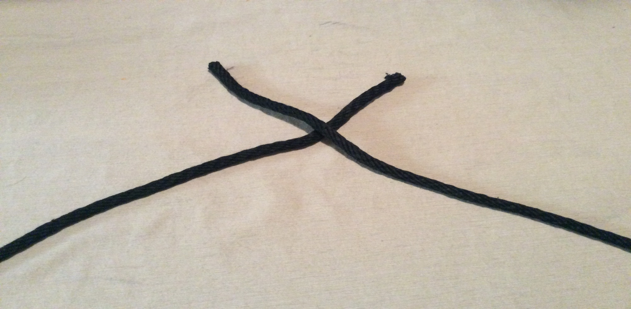
Step 2. cross ropes right over left

Slide 5
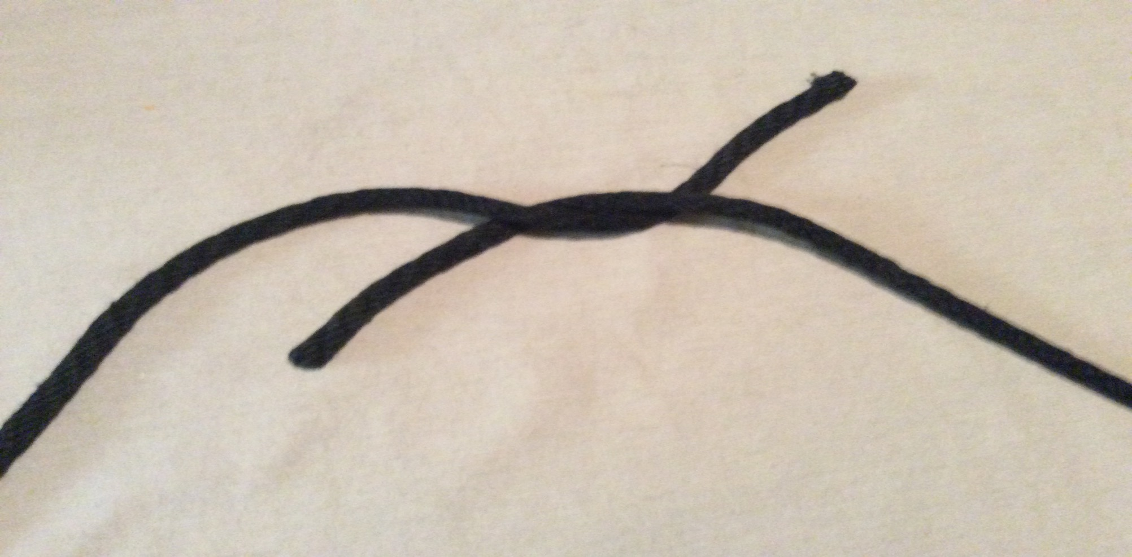
Step 3. put right under to cross left

Slide 6
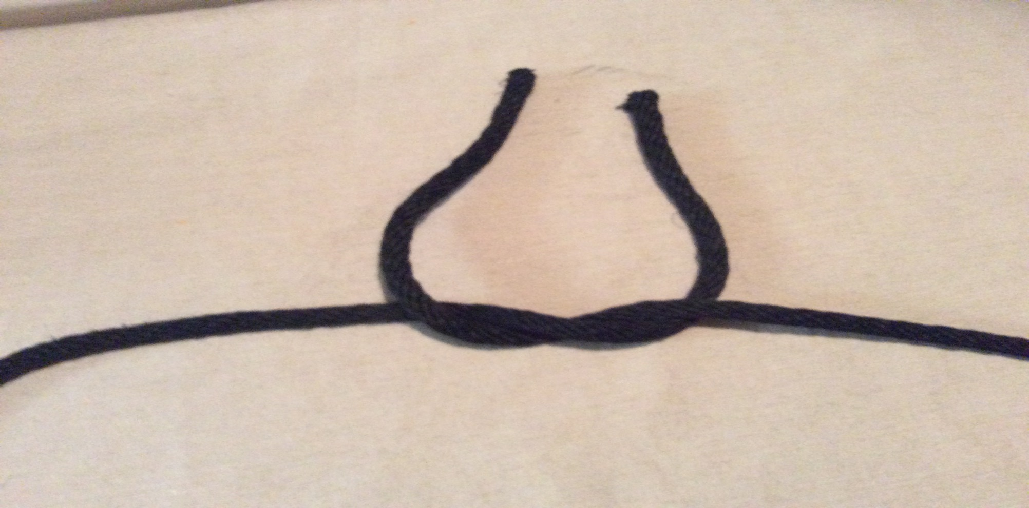
Step 4. cross right up over left to make a U shape

Slide 7
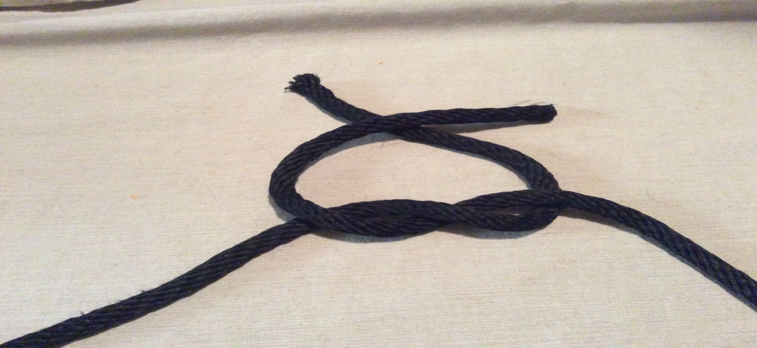
Step 5. using the upper part of the ropes cross left over right

Slide 8
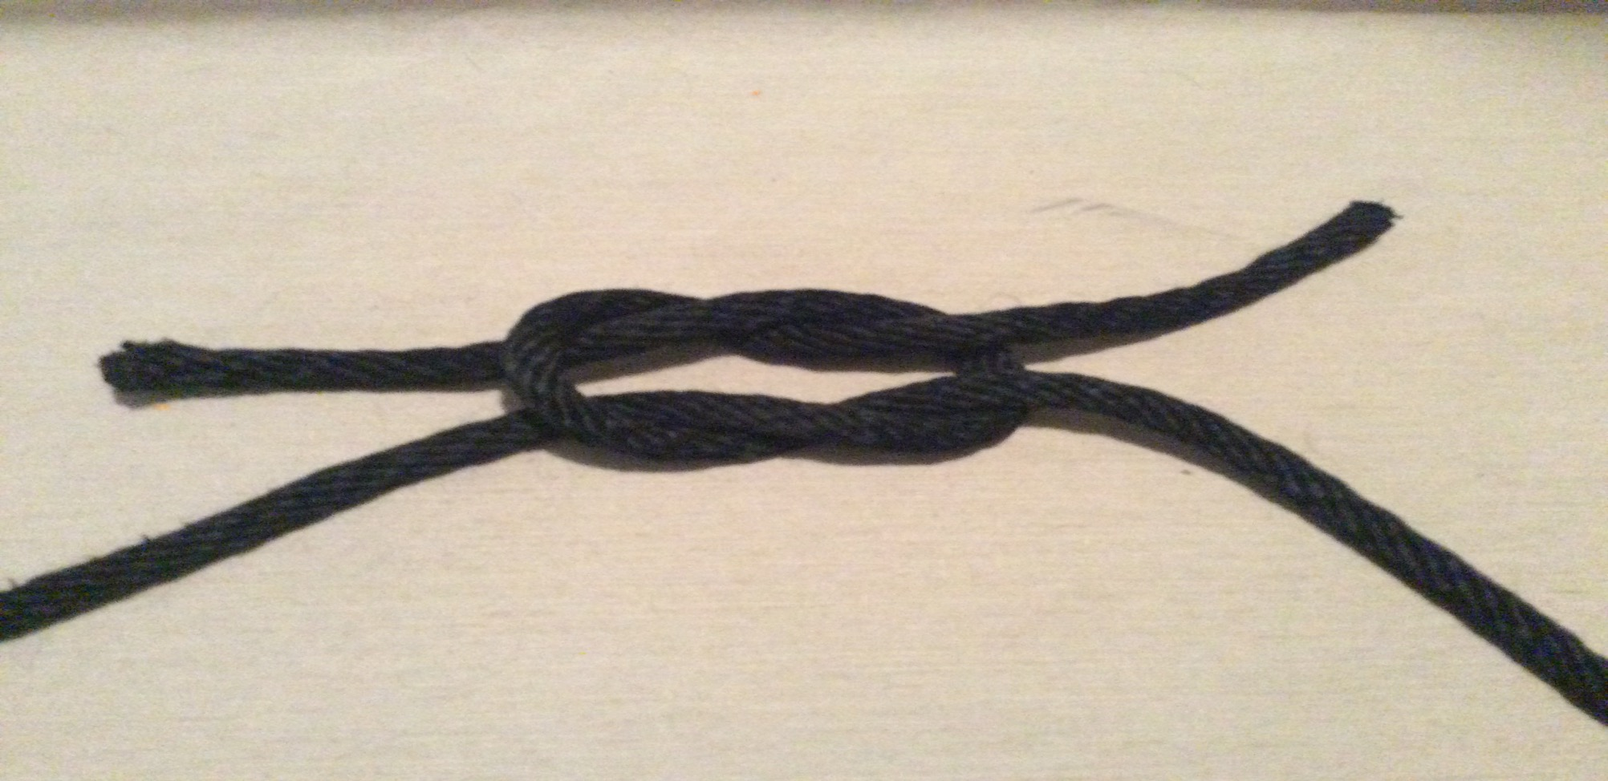
Step 6. cross left under right

Slide 9
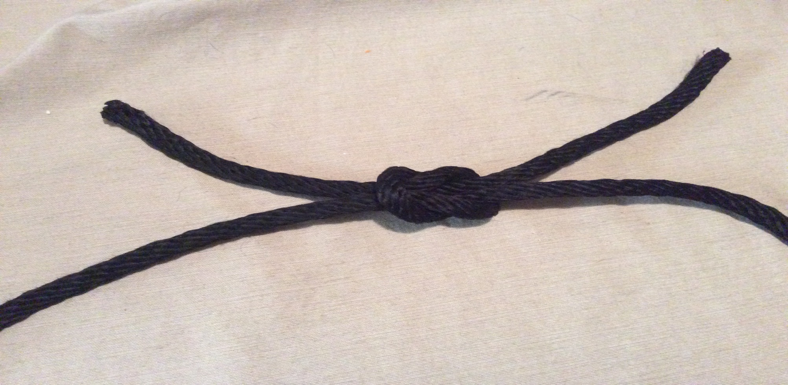
Step 7. pull the rope tight on all four of the ropes legs

Slide 10
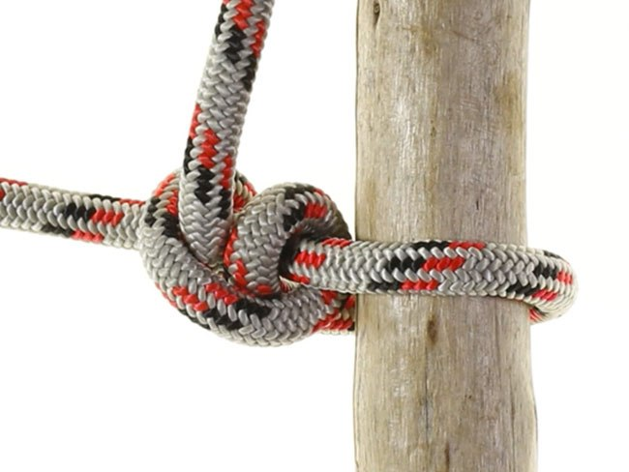
Two Half-Hitches

Slide 11
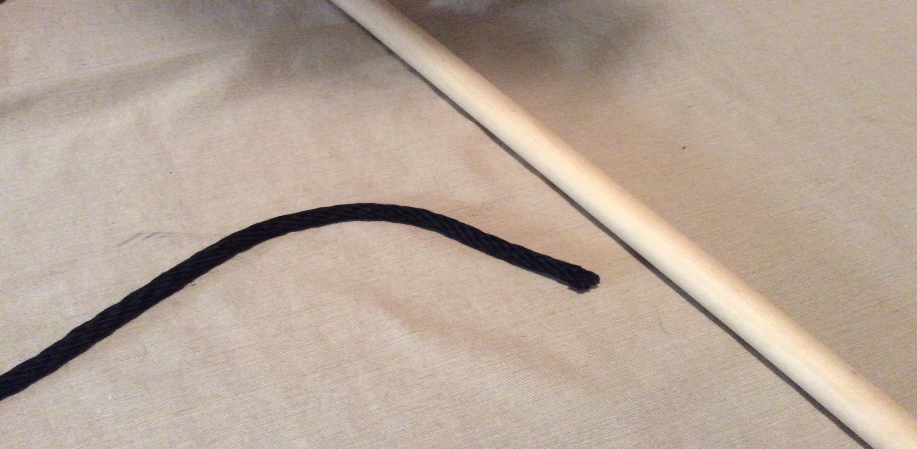
Step 1. set the rope next to the pole

Slide 12
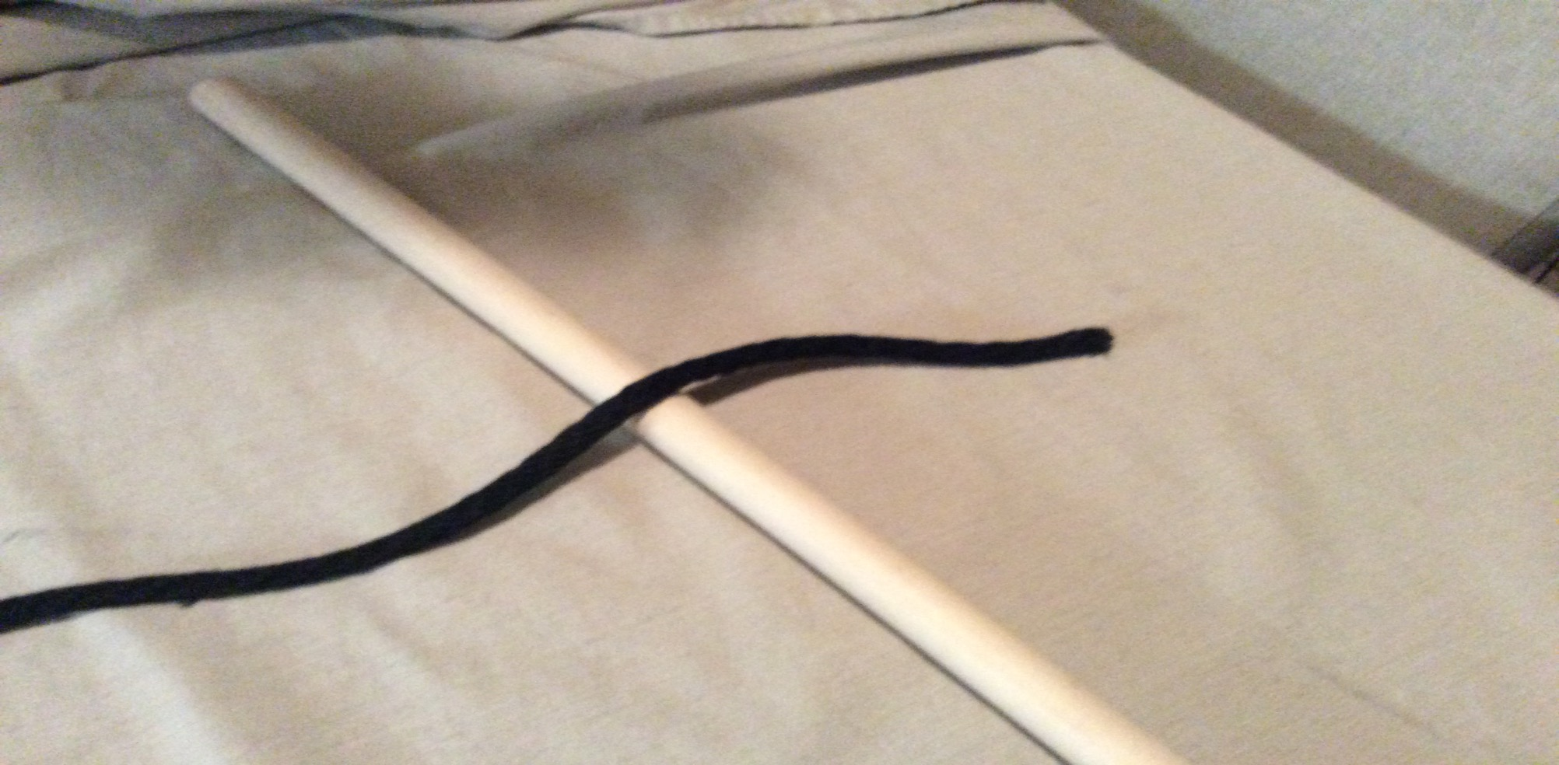
Step 2. cross rope over the pole

Slide 13
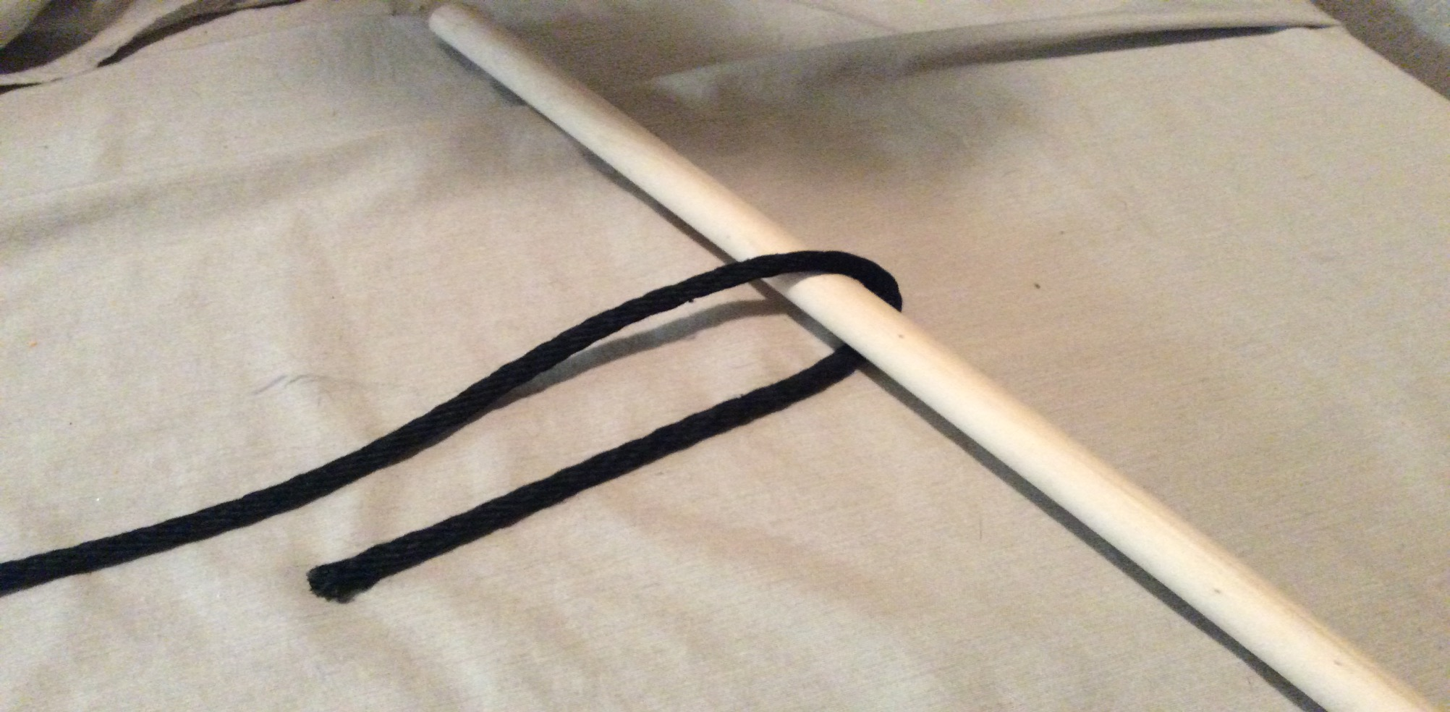
Step 3. cross the rope around the pole

Slide 14
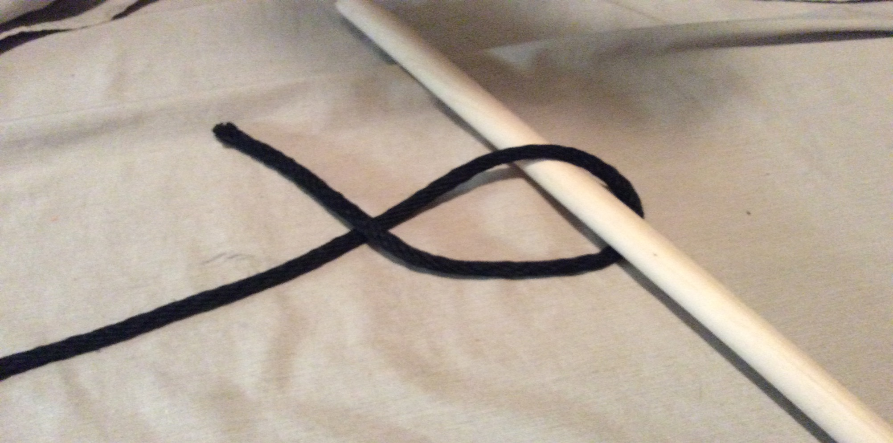
Step 4. cross the end of the rope

Slide 15
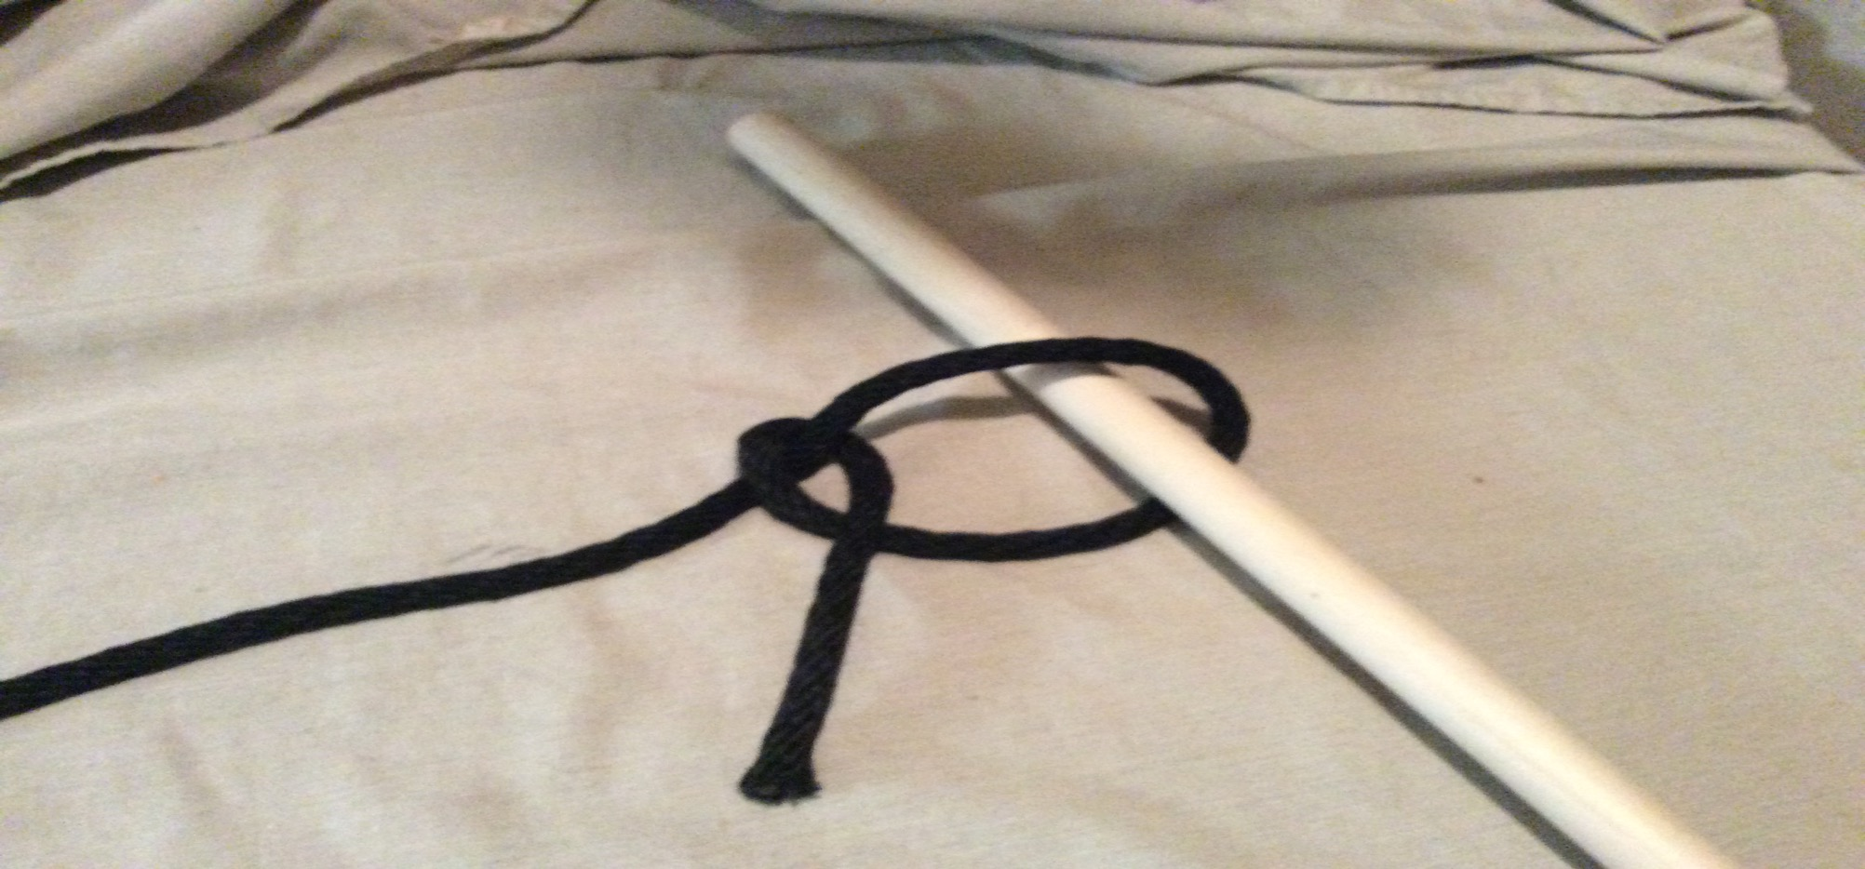
Step 5. wrap the end of the rope around the other side of the rope

Slide 16
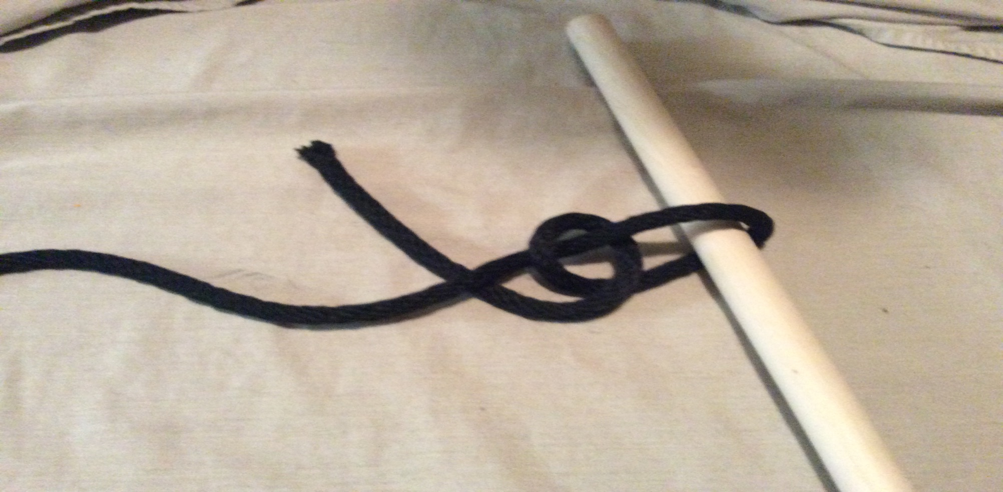
Step 6. cross the rope under the other side or the rope

Slide 17
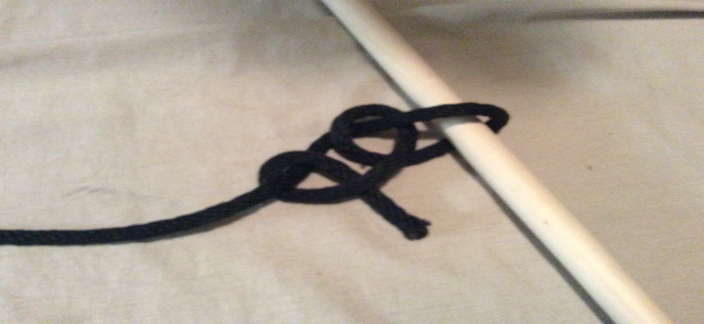
Step 7. cross the rope back around the other side of the rope towards you

Slide 18
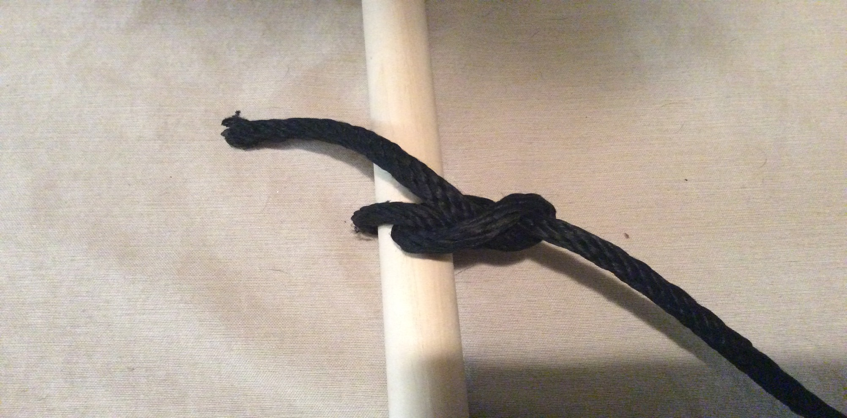
Step 8. hold the ends of the rope and pull tight

Slide 19
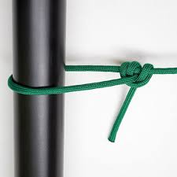
Taut-Line Hitch

Slide 20
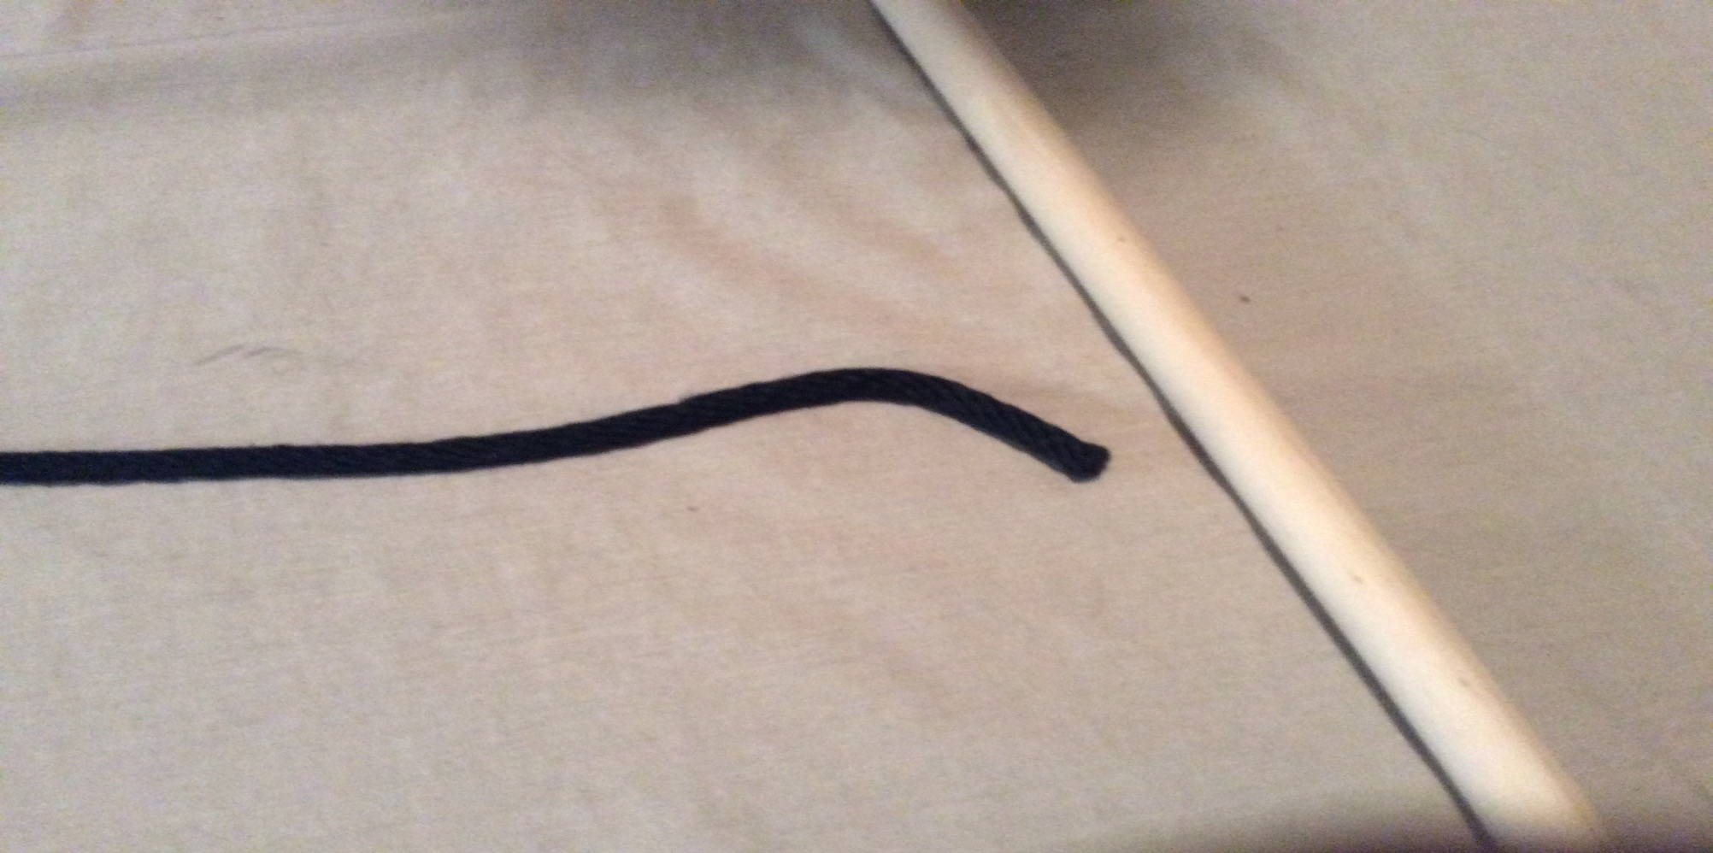
Step 1. lay the rope next to the pole

Slide 21
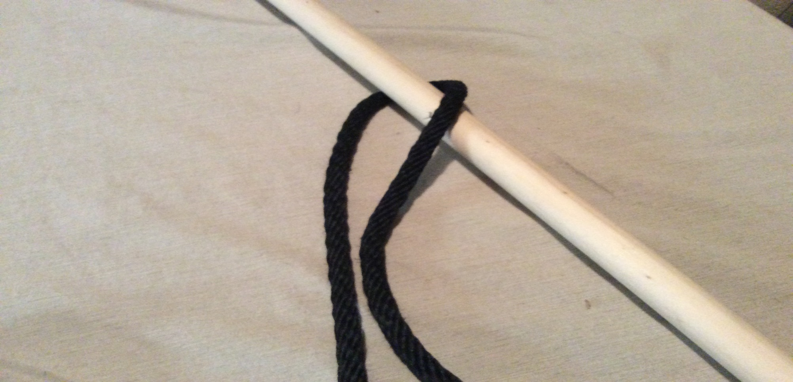
Step 2. wrap the rope around the pole

Slide 22
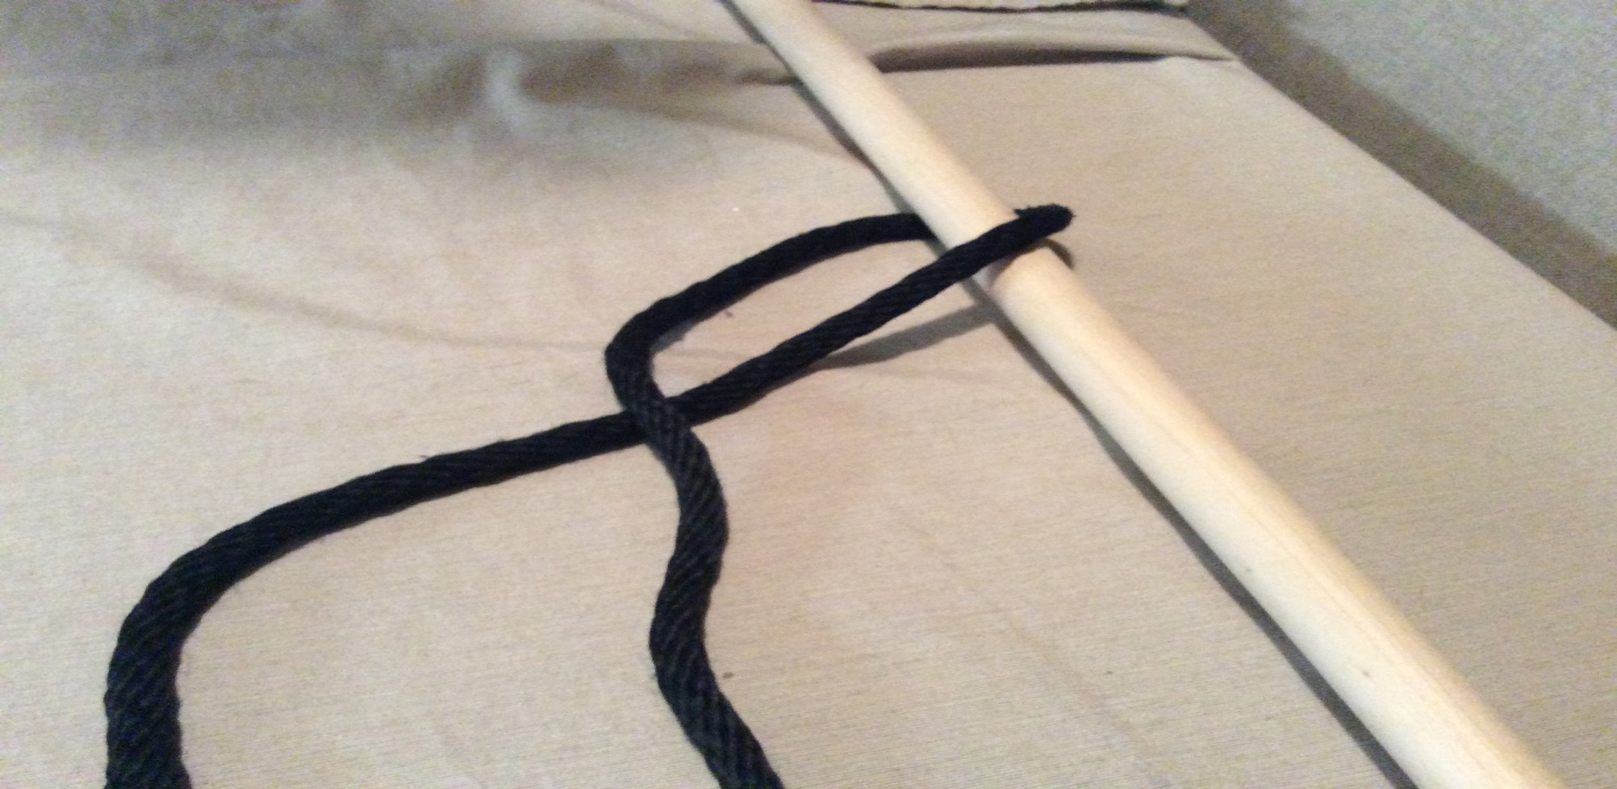
Step 3. cross both ends of the rope

Slide 23
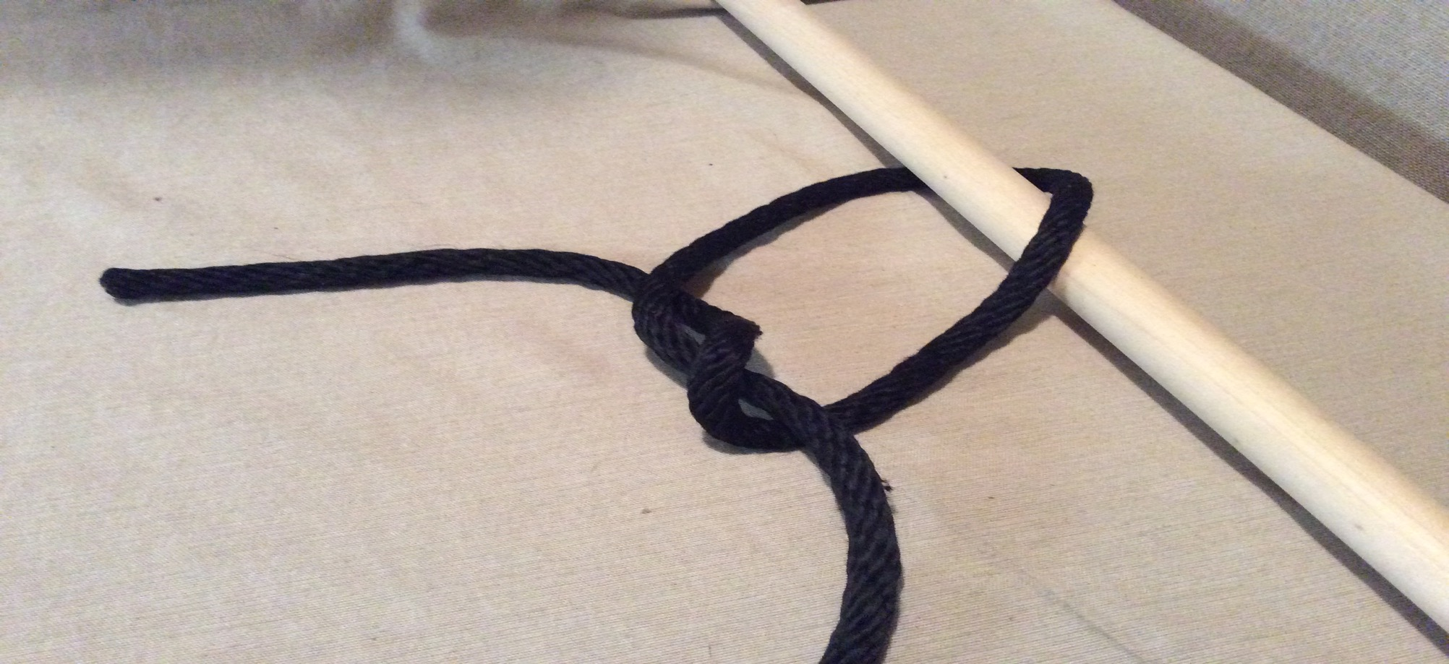
Step 4. make a figure eight with the crossed end around the other side of the rope on the inside of the loop

Slide 24
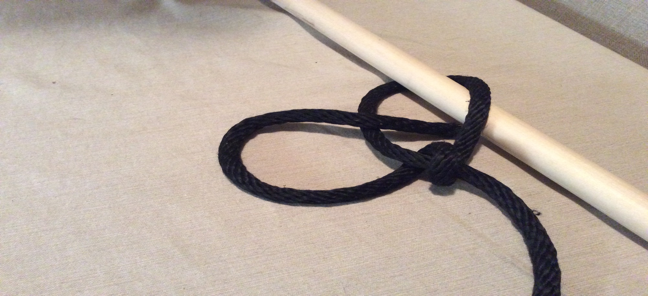
Step 5. cross the end of the rope around the othe side of the rope

Slide 25
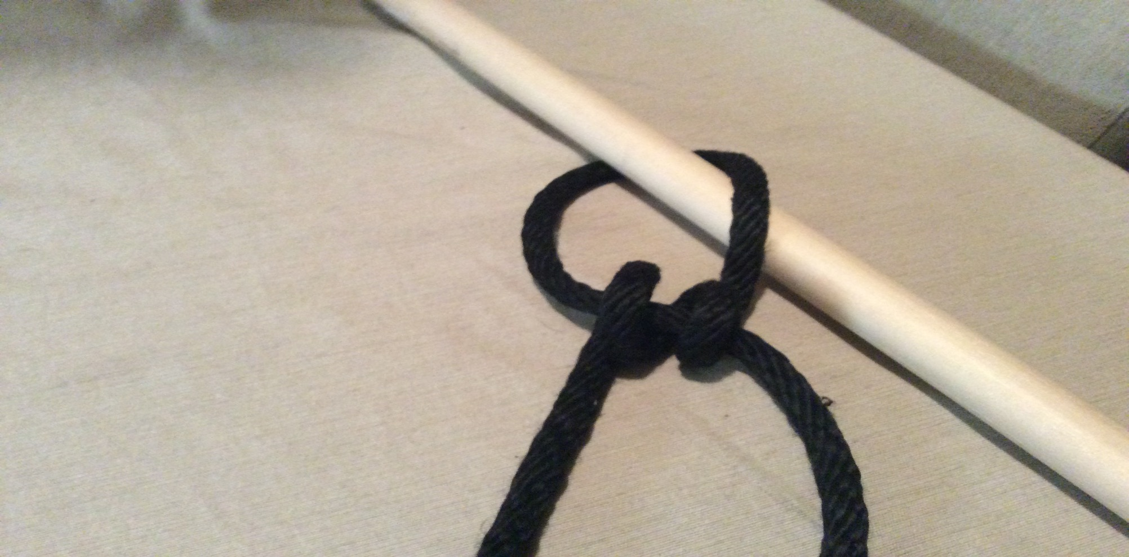
Step 6. pull the two loops close together

Slide 26
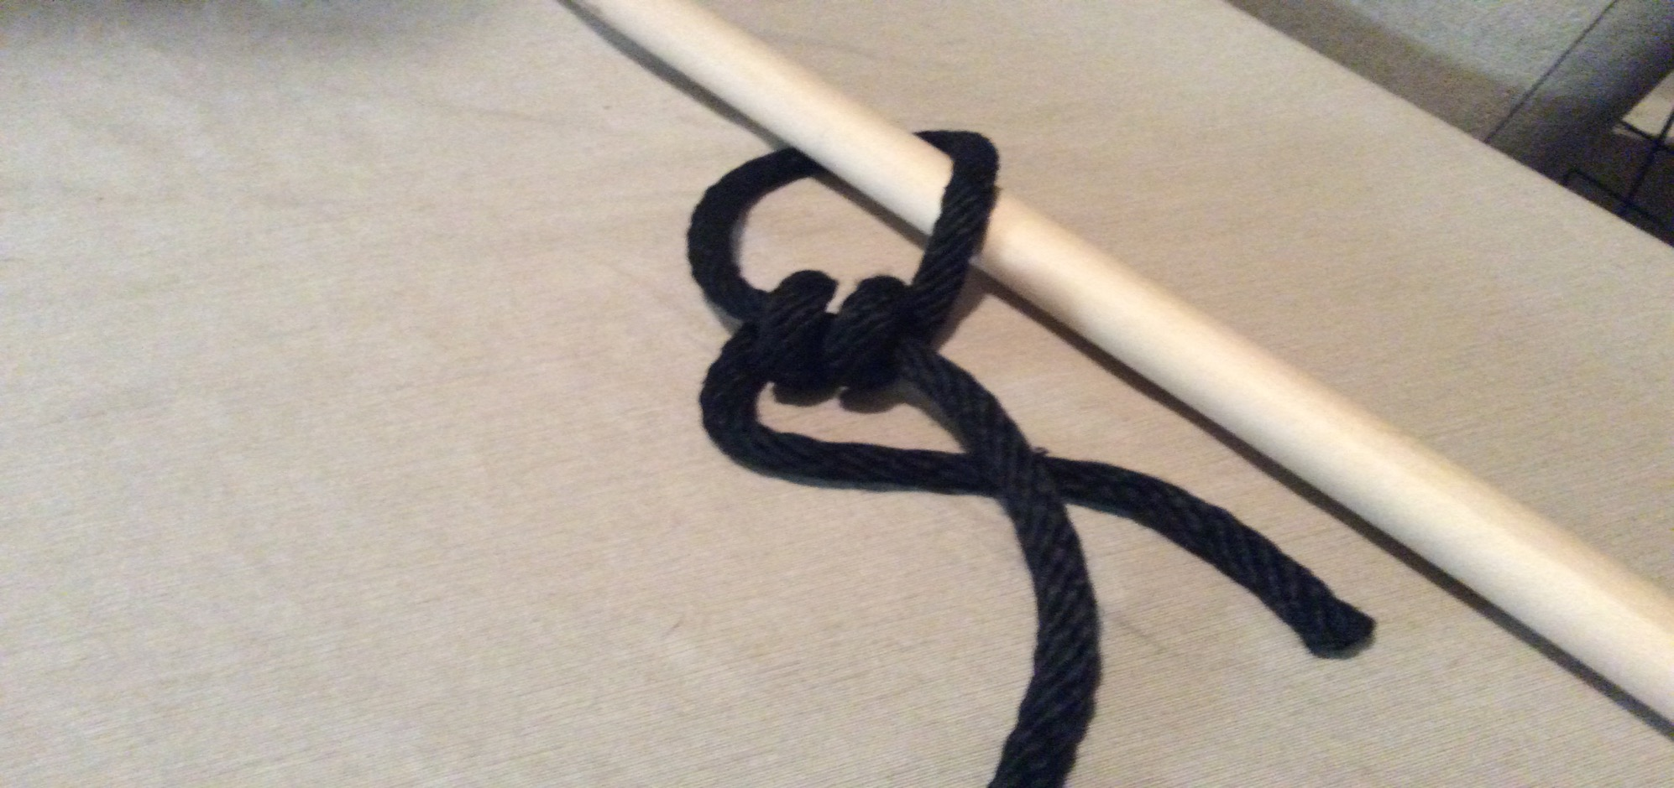
Step 7. cross the end of the rope around the other side of the rope on the outside of the loop

Slide 27
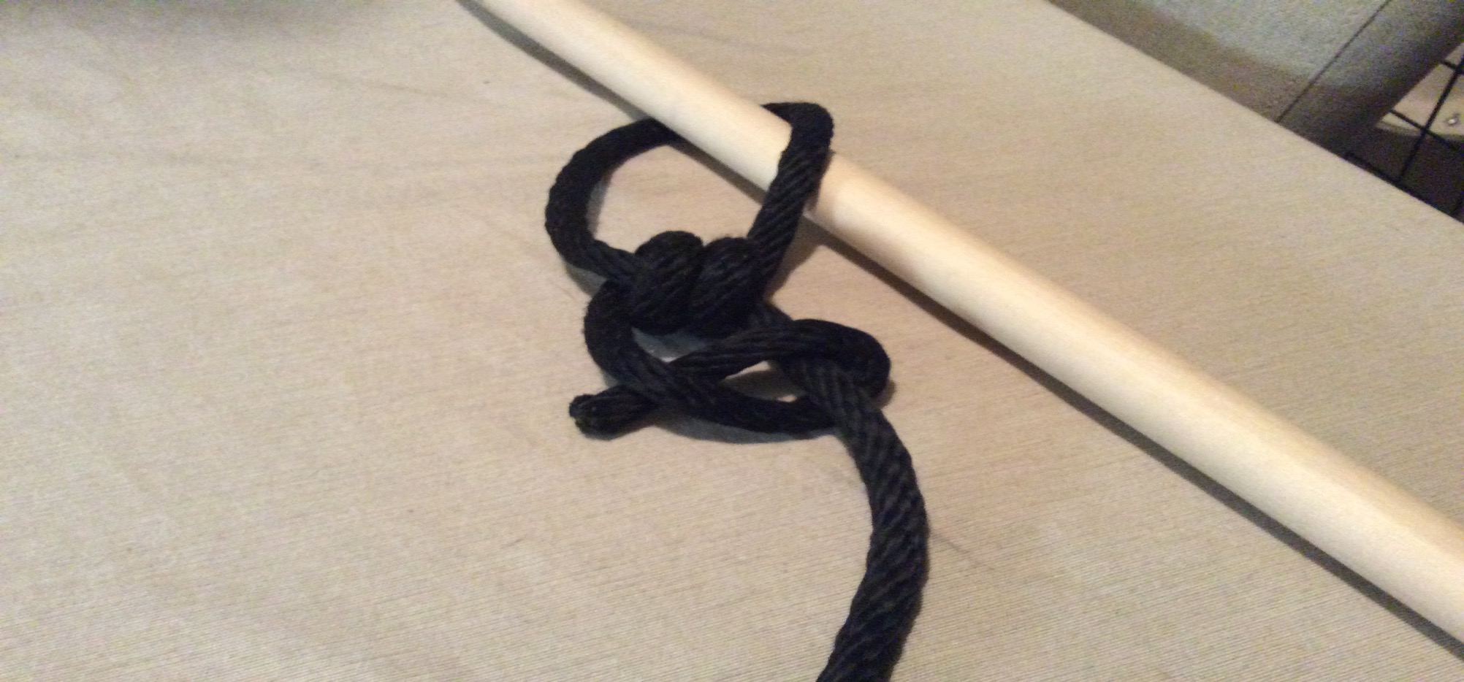
Step 8. cross the end of the rope around the other side of the rope

Slide 28
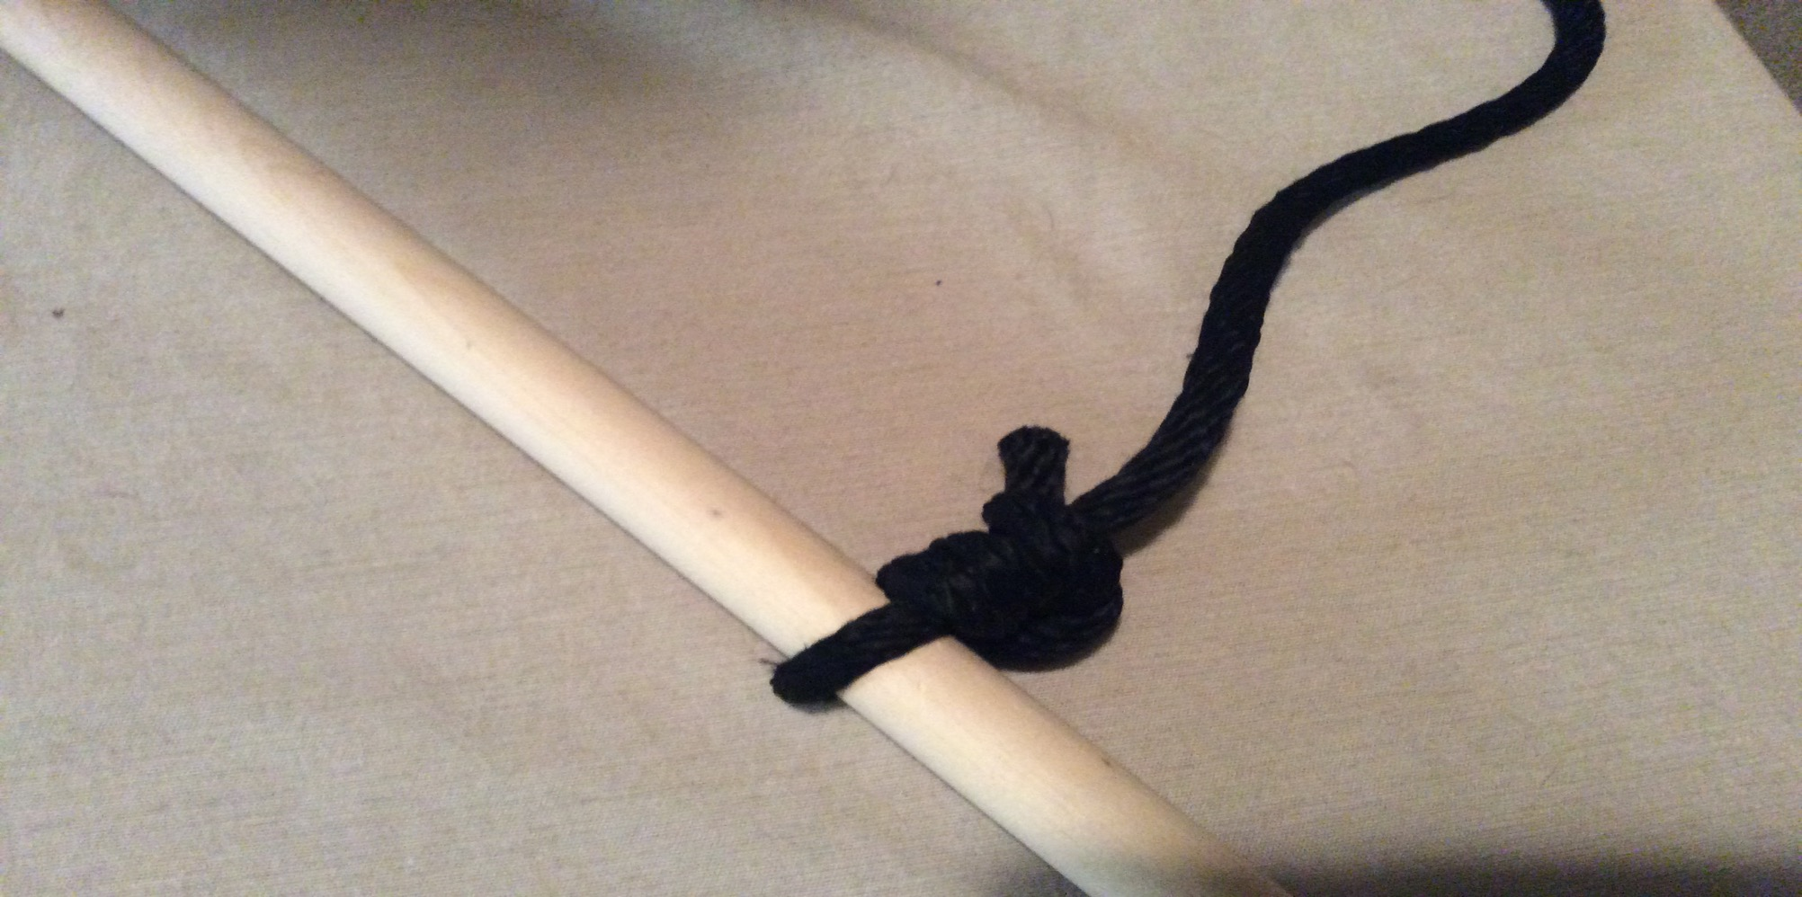
Step 9. pull the rope tight

Slide 29
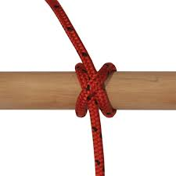
Clove Hitch

Slide 30
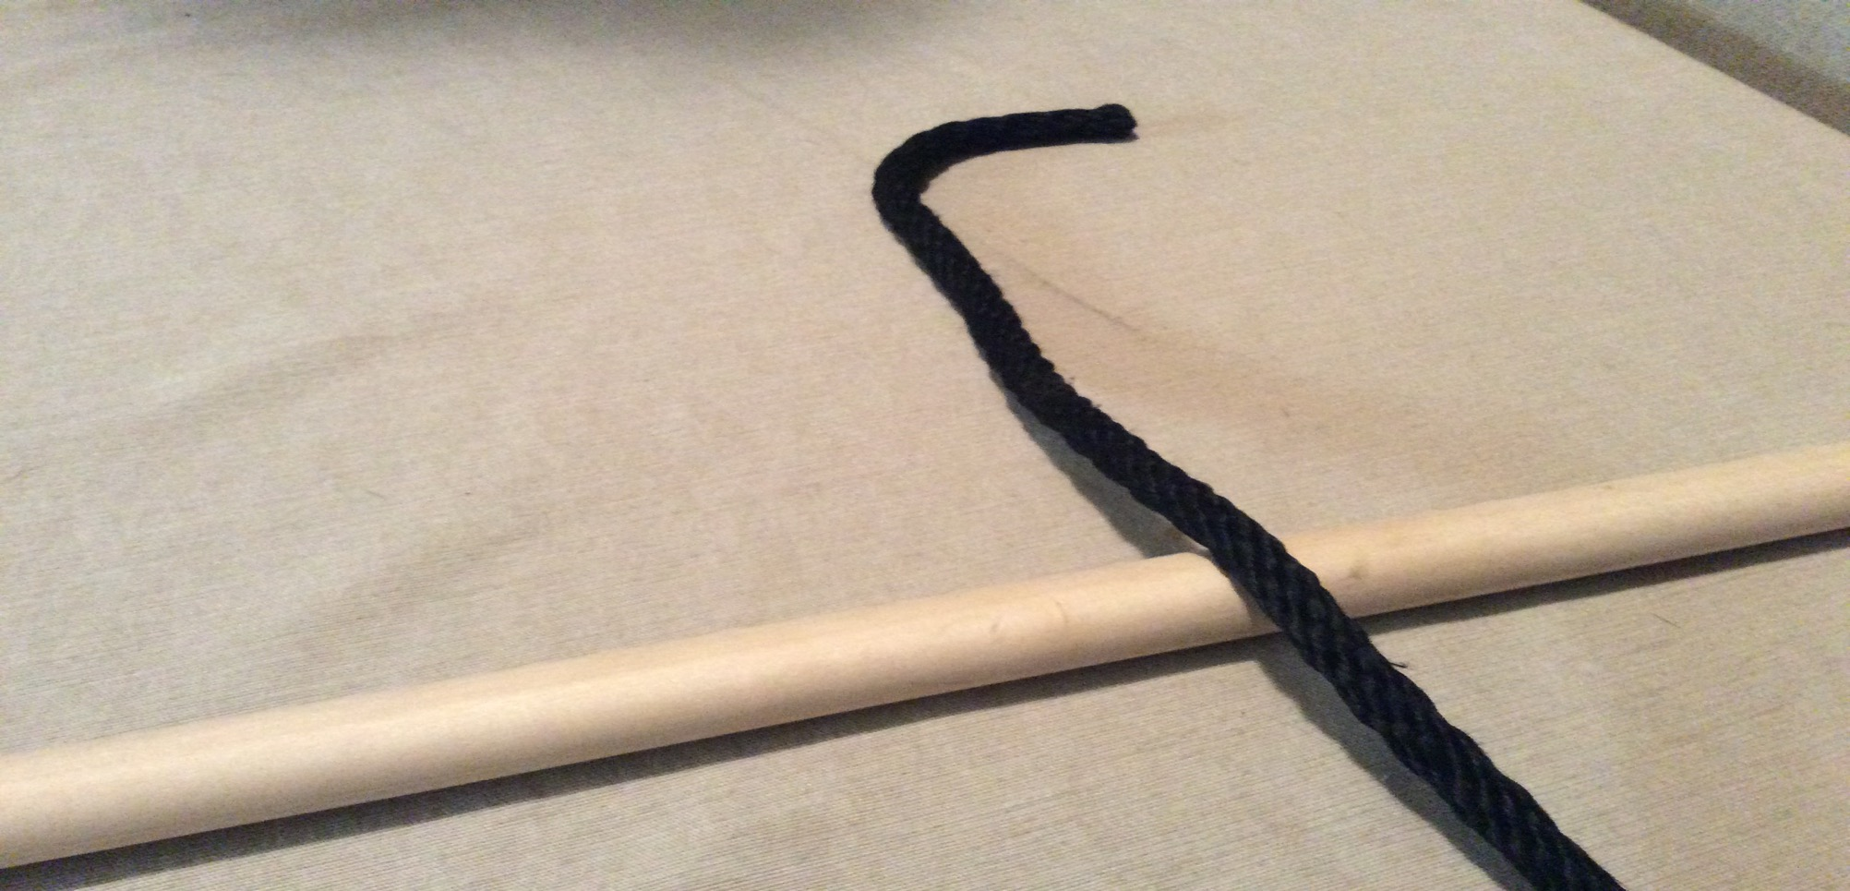
Step 1. lay the rope across the pole

Slide 31
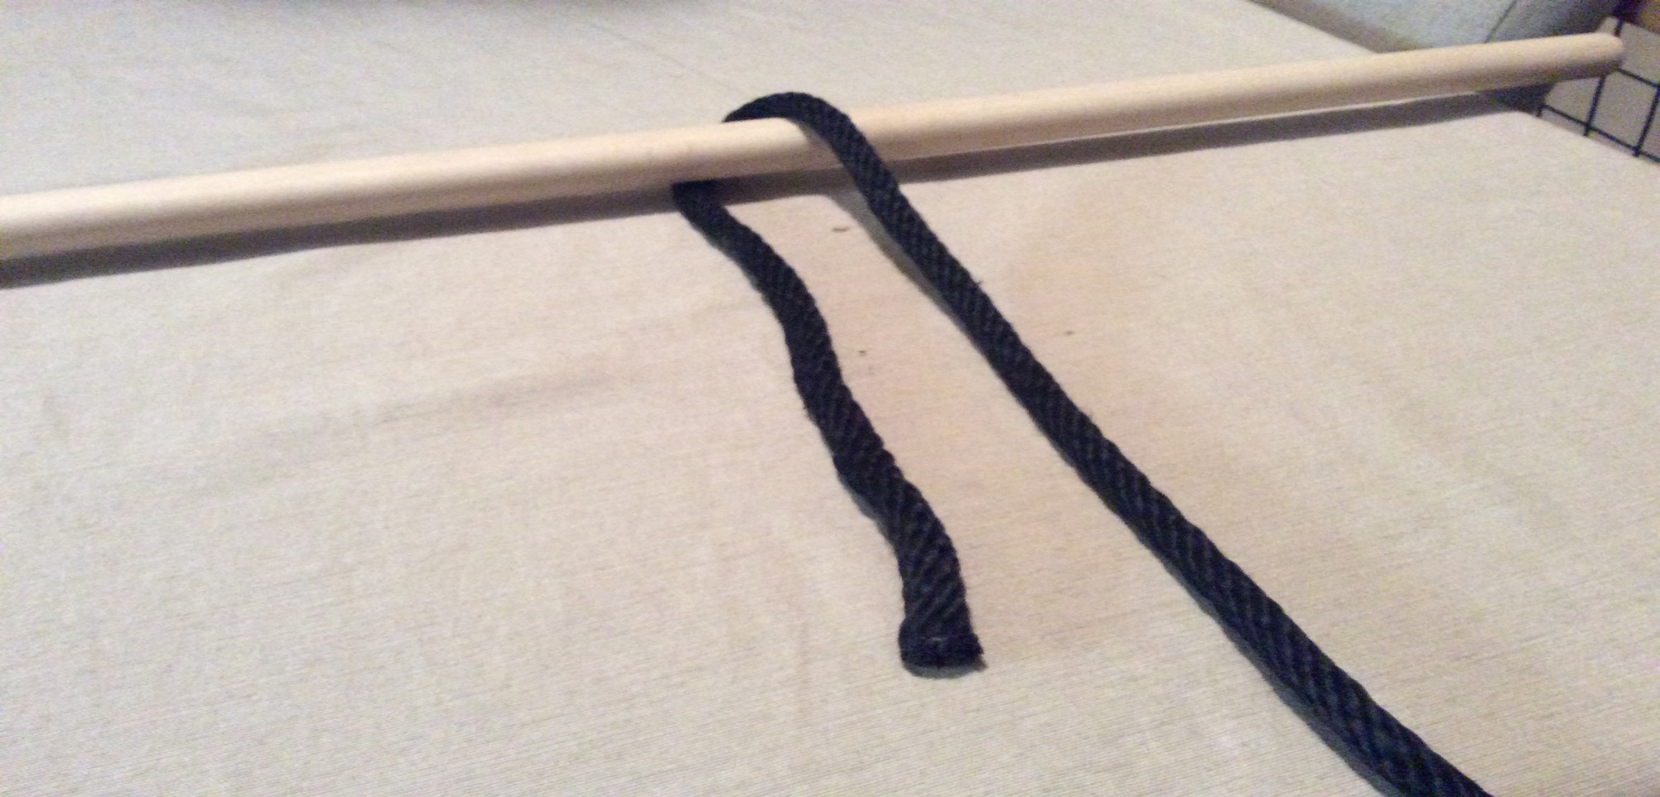
Step 2. Wrap the rope around the pole

Slide 32
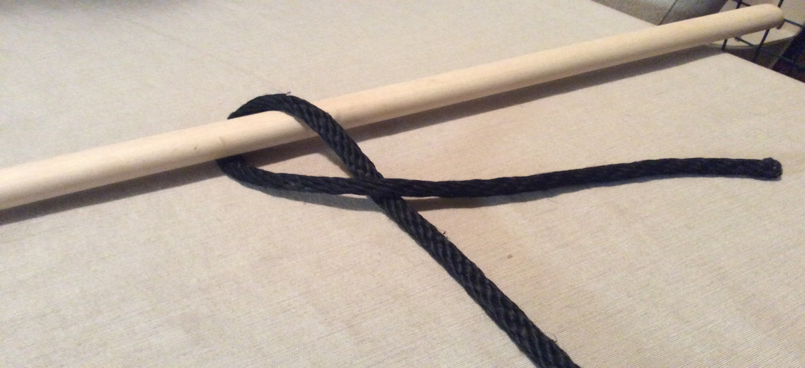
Step 3. cross end of the rope around the other side of the rope

Slide 33
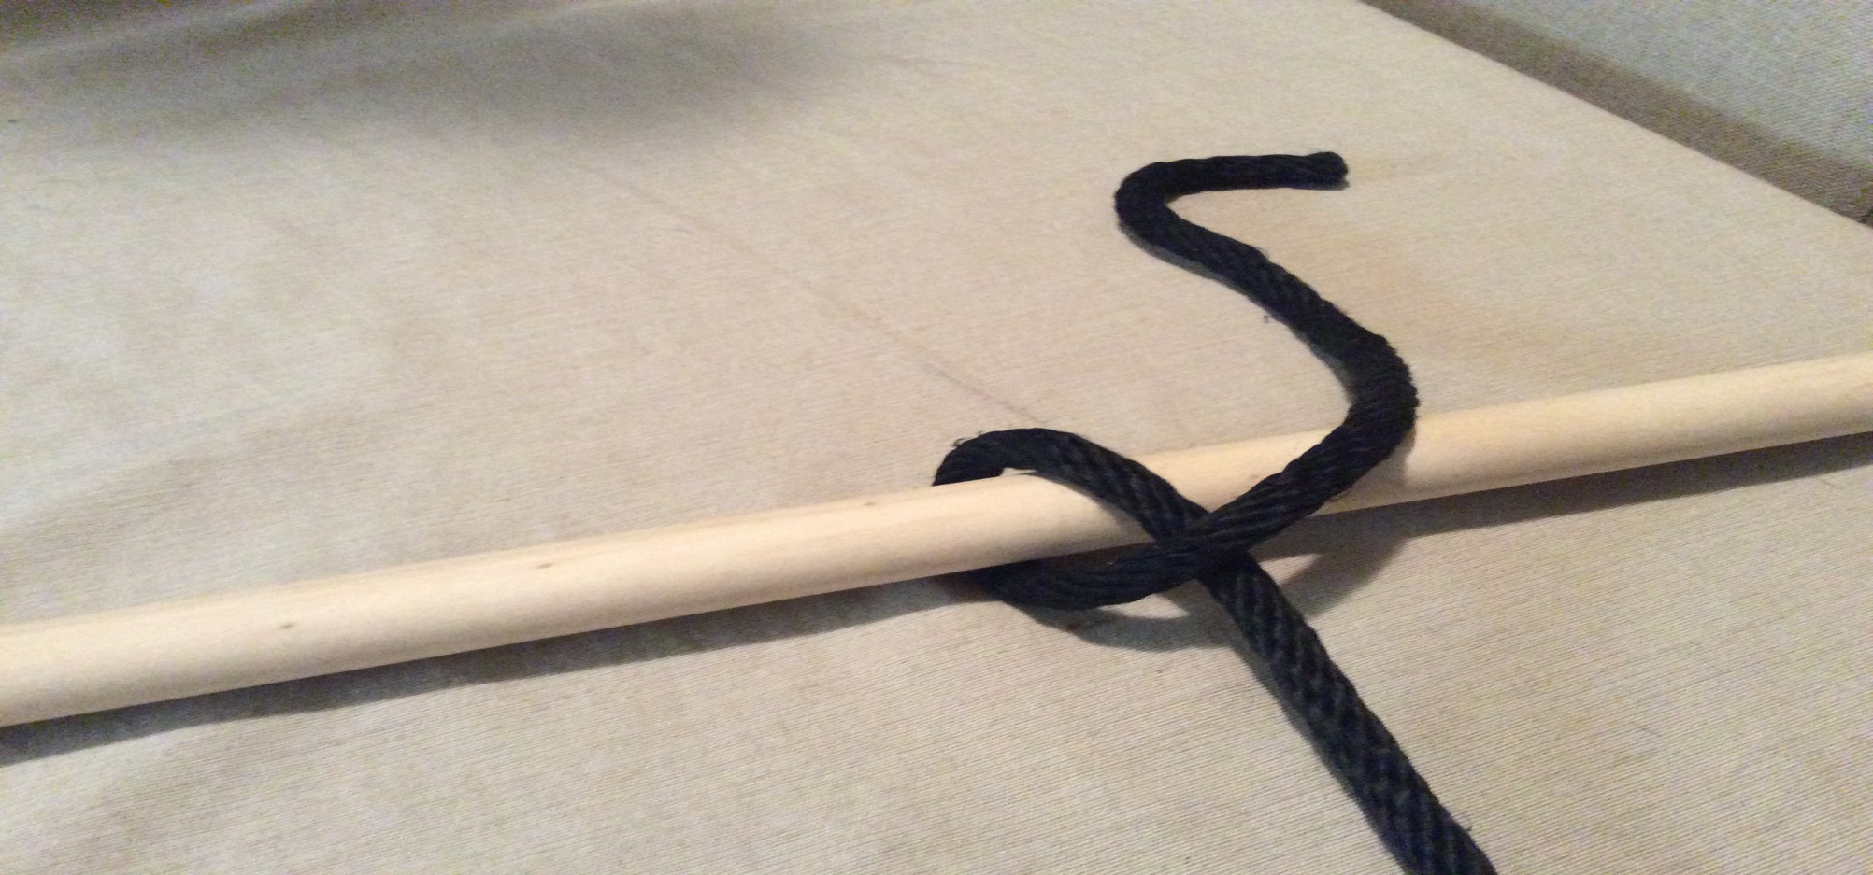
Step 4. put end of the rope on the pole and across the rope

Slide 34
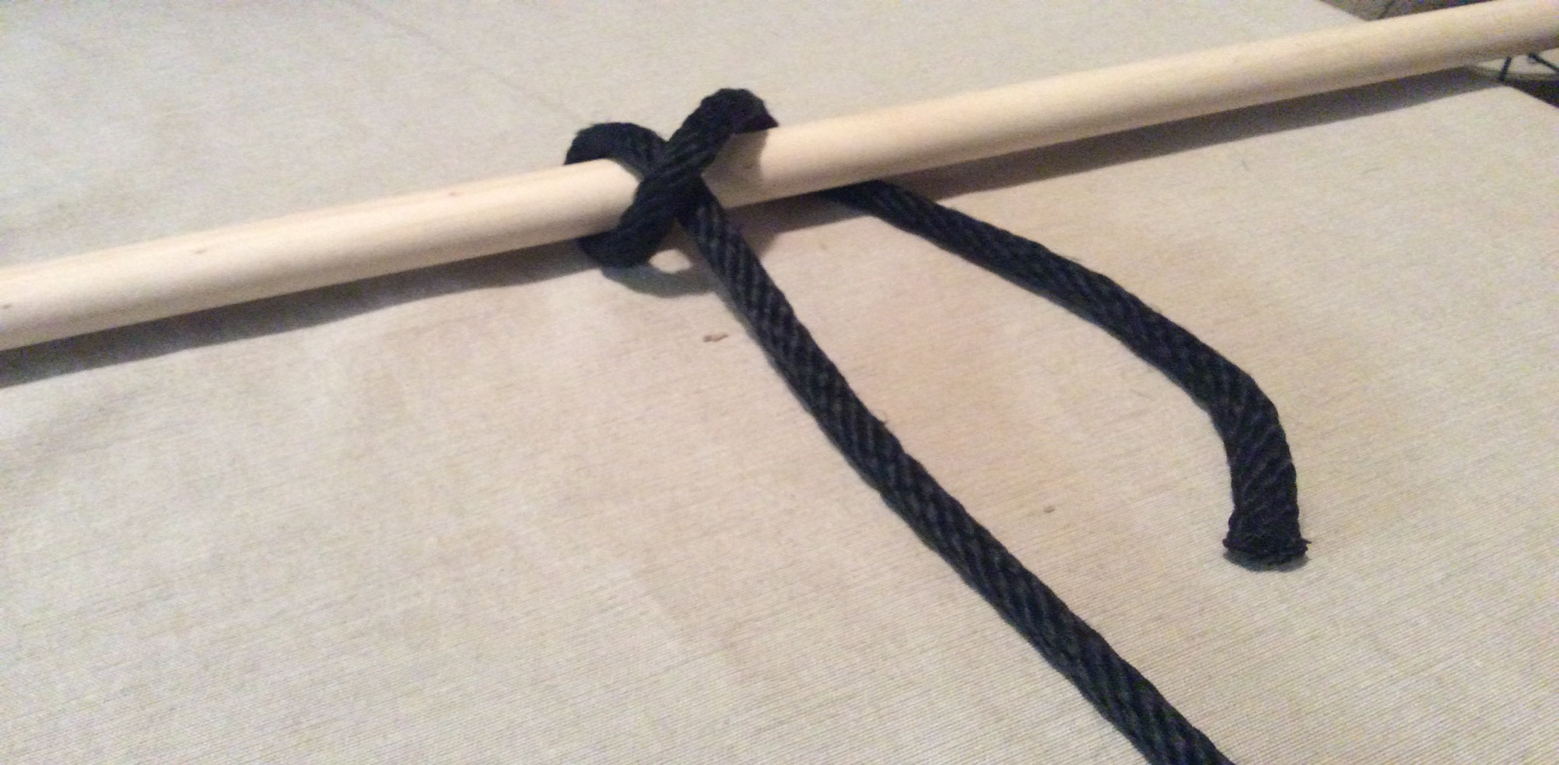
Step 5. pull end of the rope around the pole

Slide 35
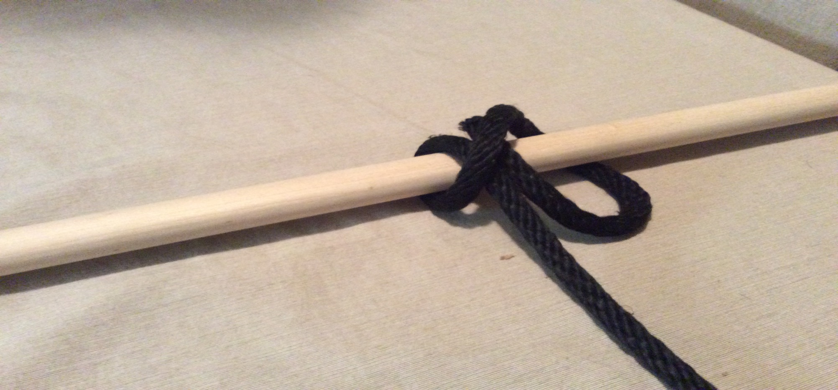
Step 6. bring the end of the rope under the cross in the rope on the pole

Slide 36
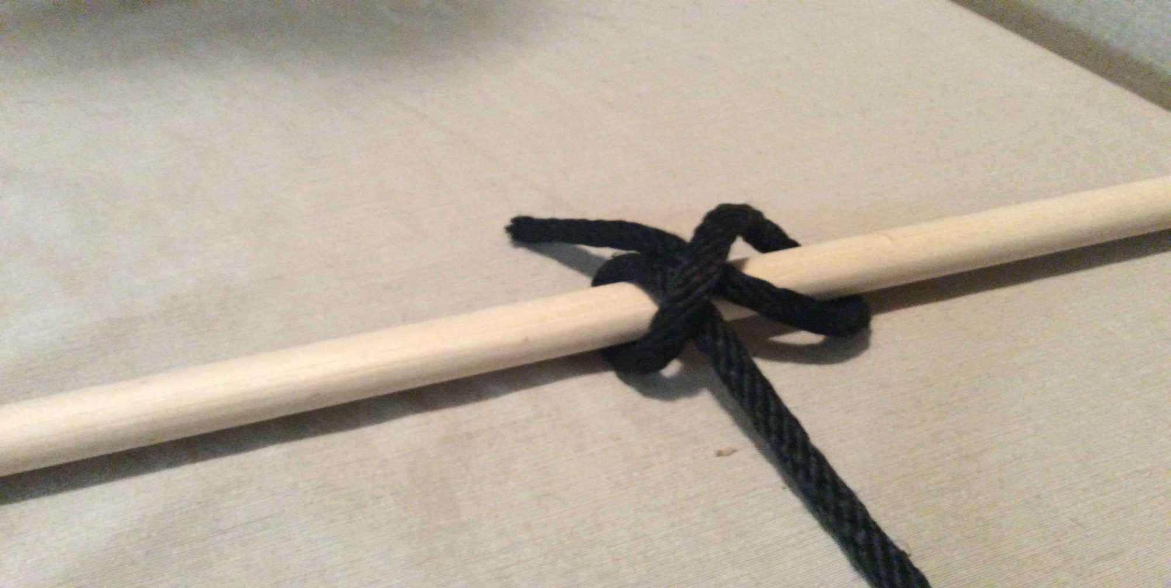
Step 7. line up the loops

Slide 37
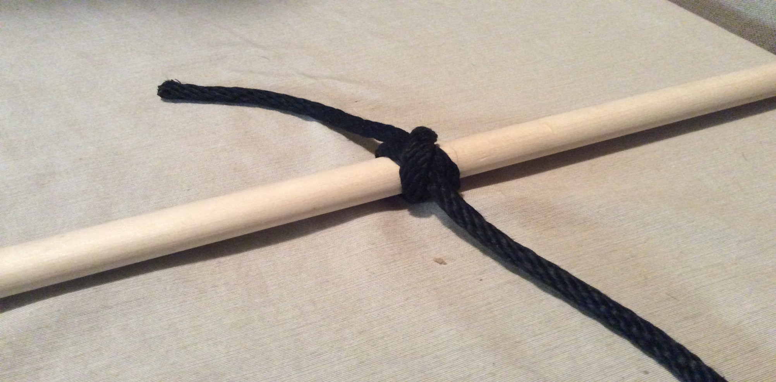
Step 8. pull tightly on the rope

Slide 38
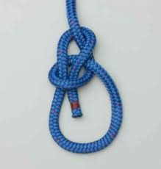
Bowline

Slide 39
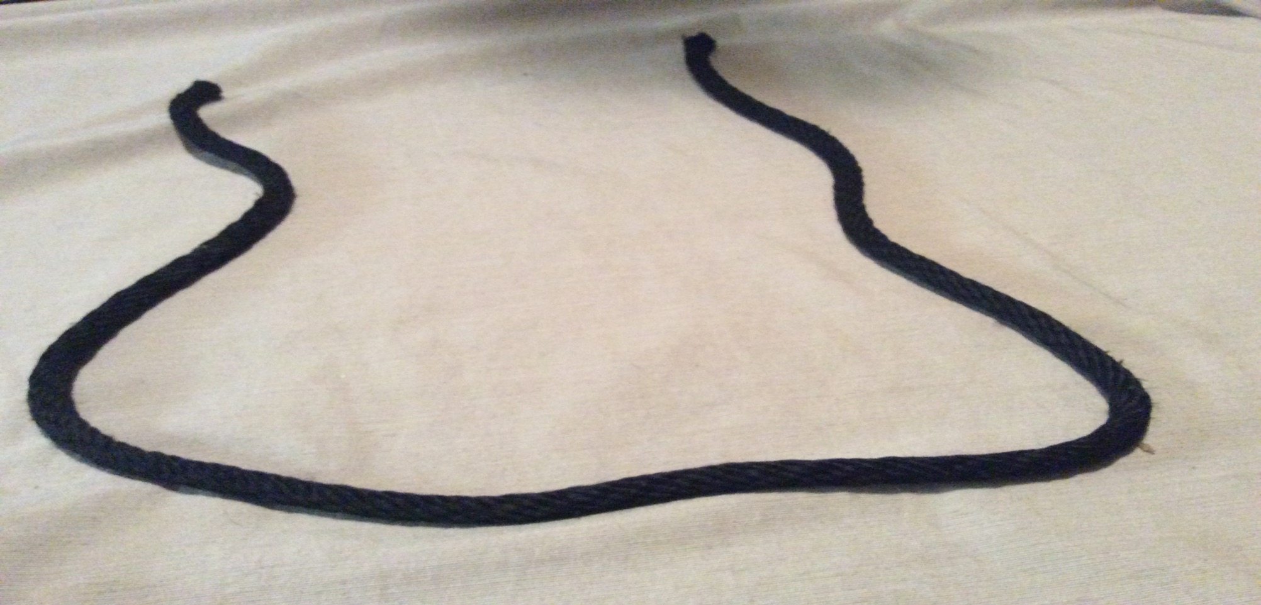
Step 1. make a U shape with the rope

Slide 40
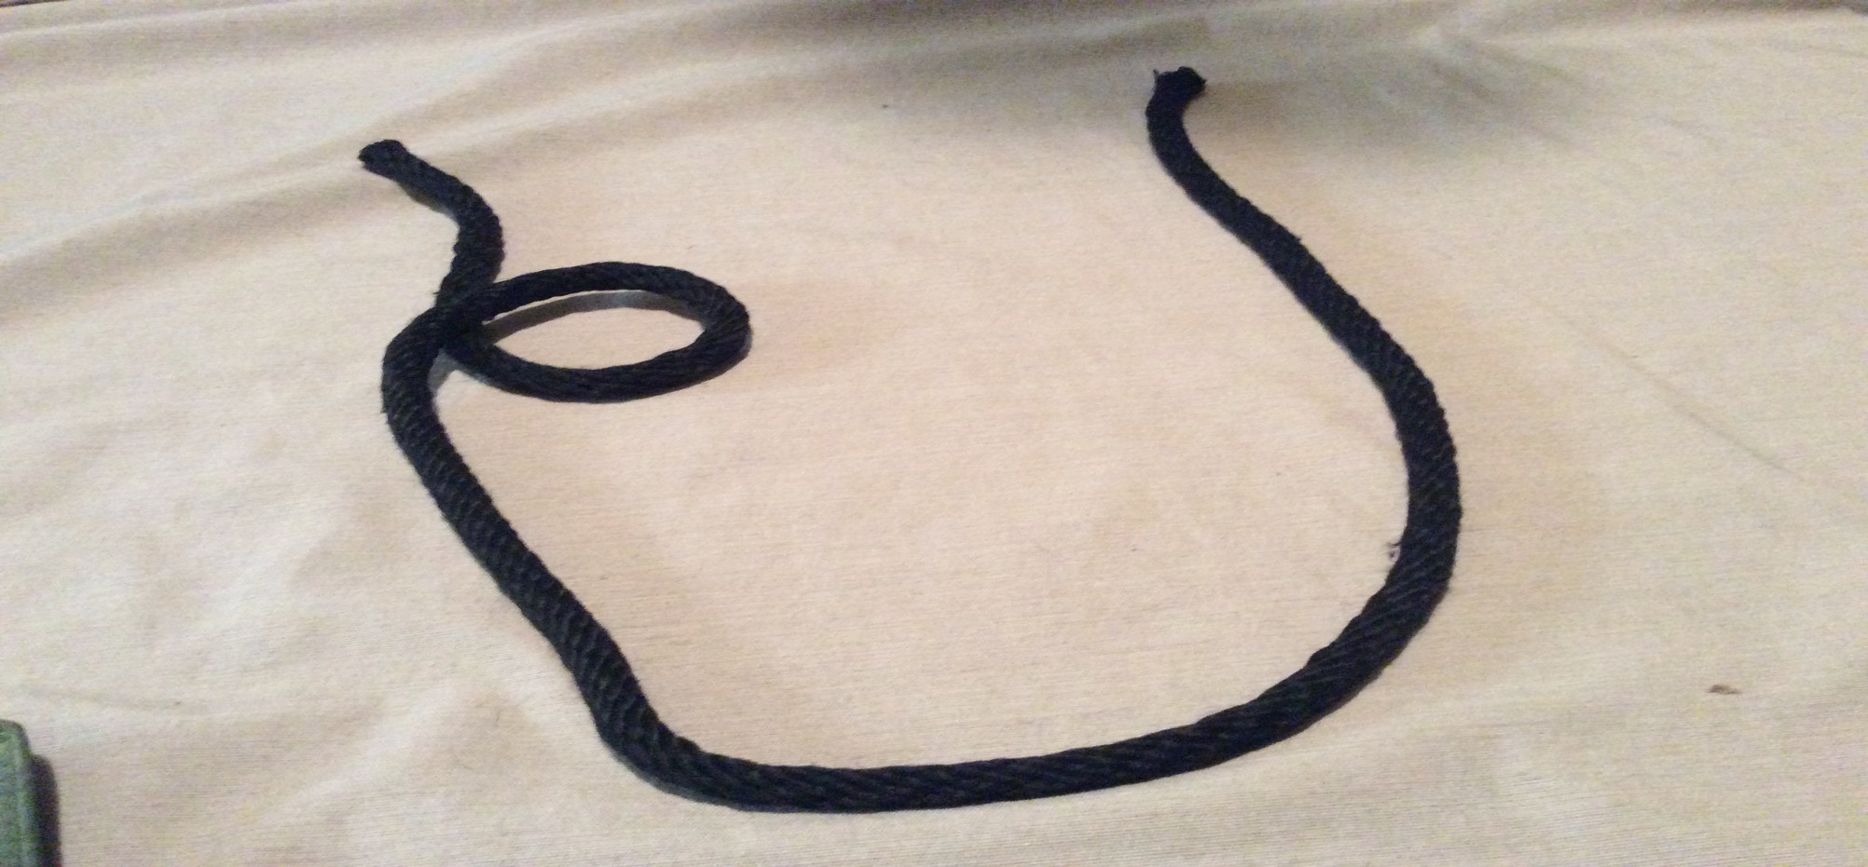
Step 2. make a circle with the end under on the left side of the rope

Slide 41
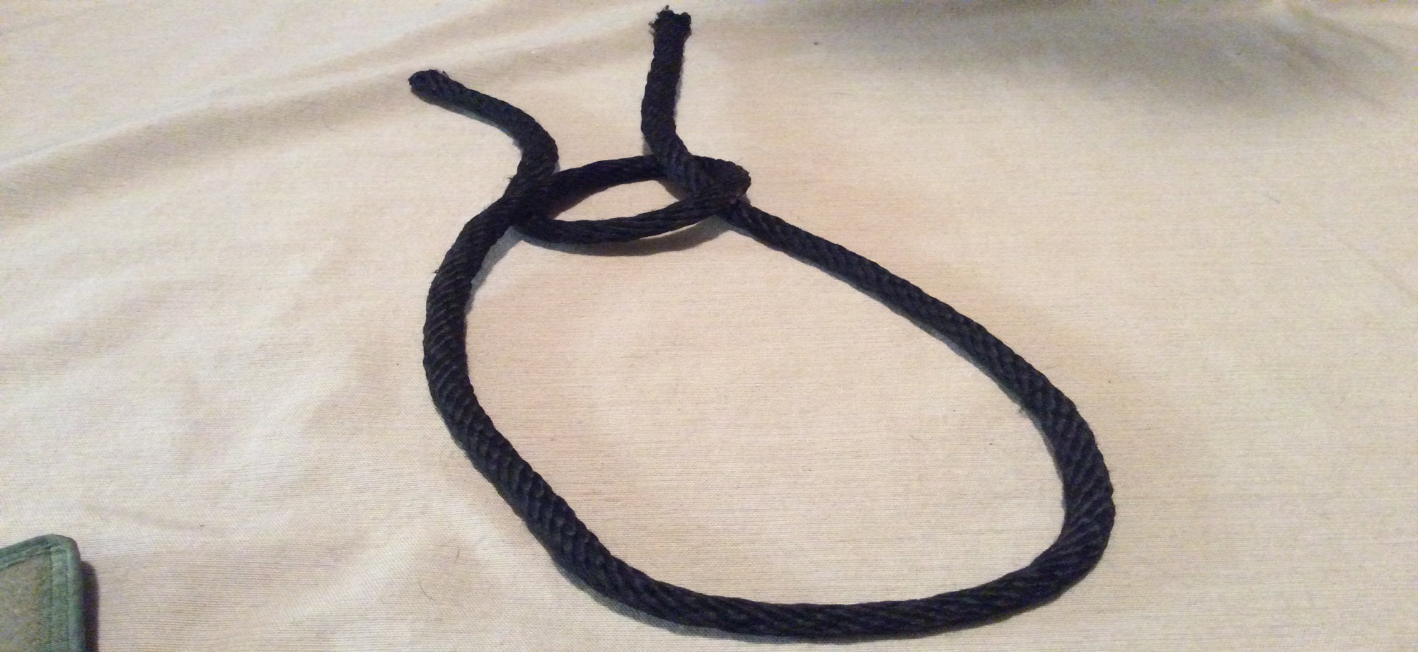
Step 3. put the other end of the rope through the loop

Slide 42
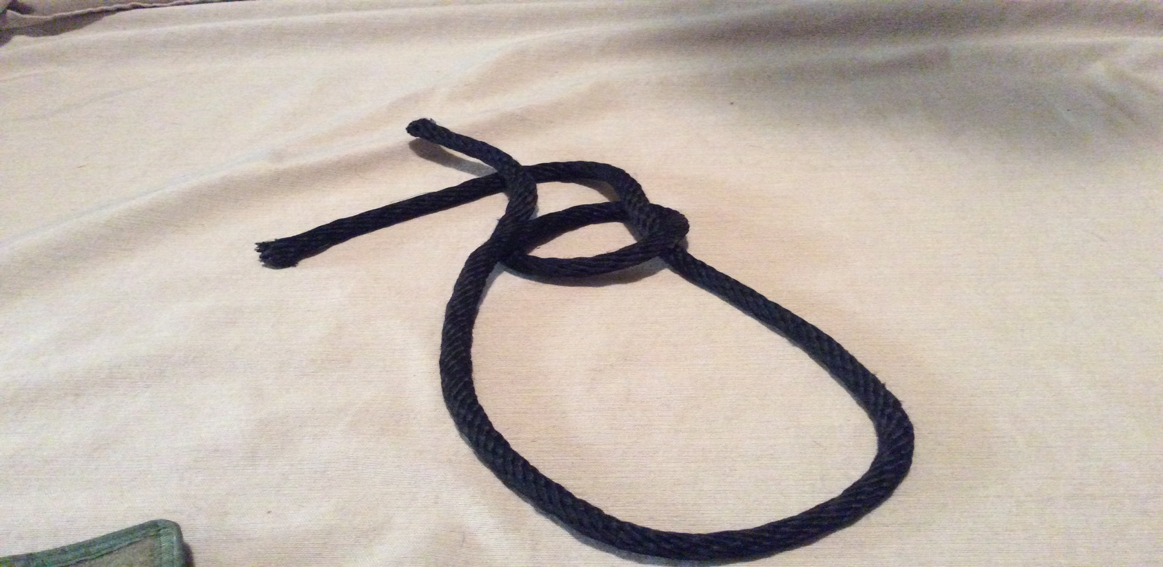
Step 4. cross the right rope under the left rope

Slide 43
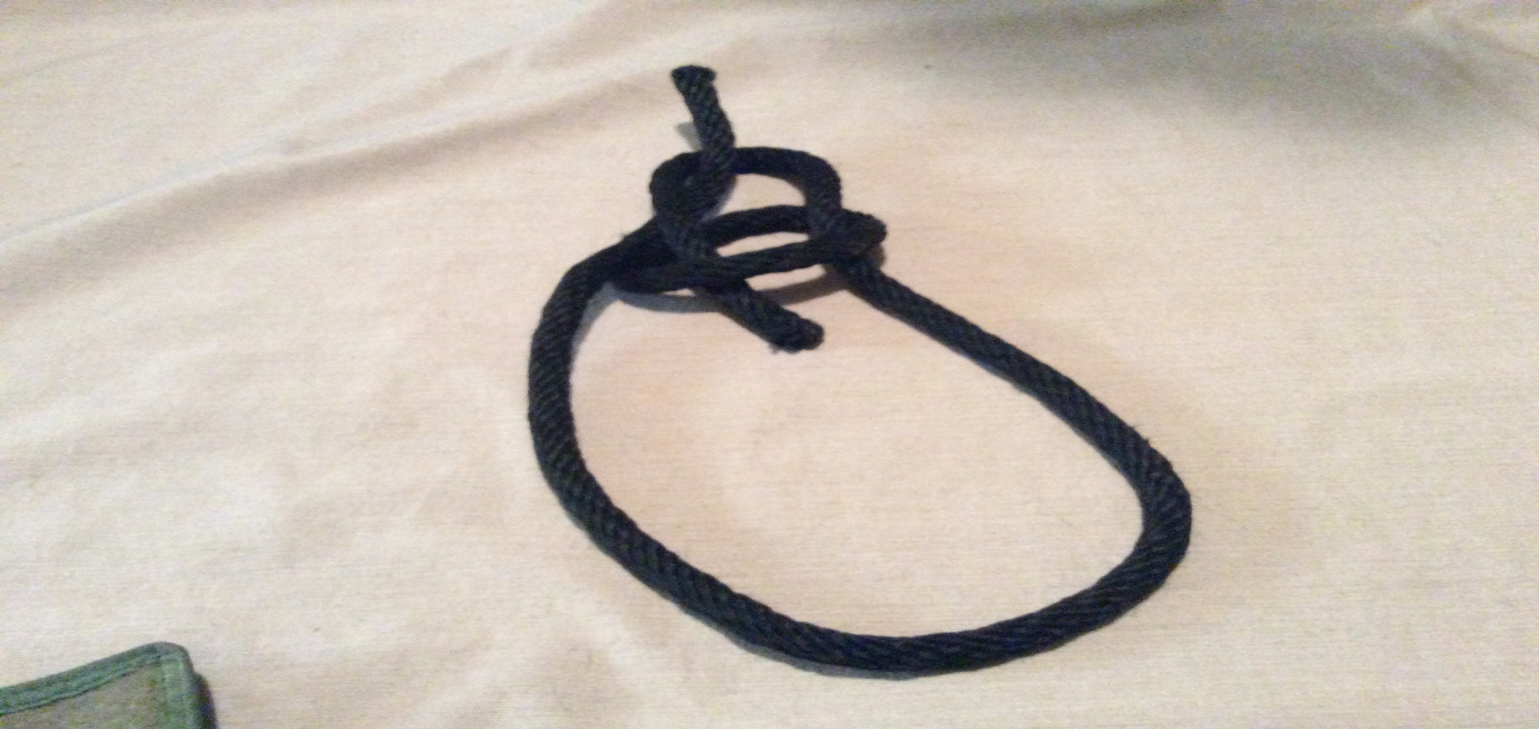
Step 5. bring the right rope into the loop

Slide 44
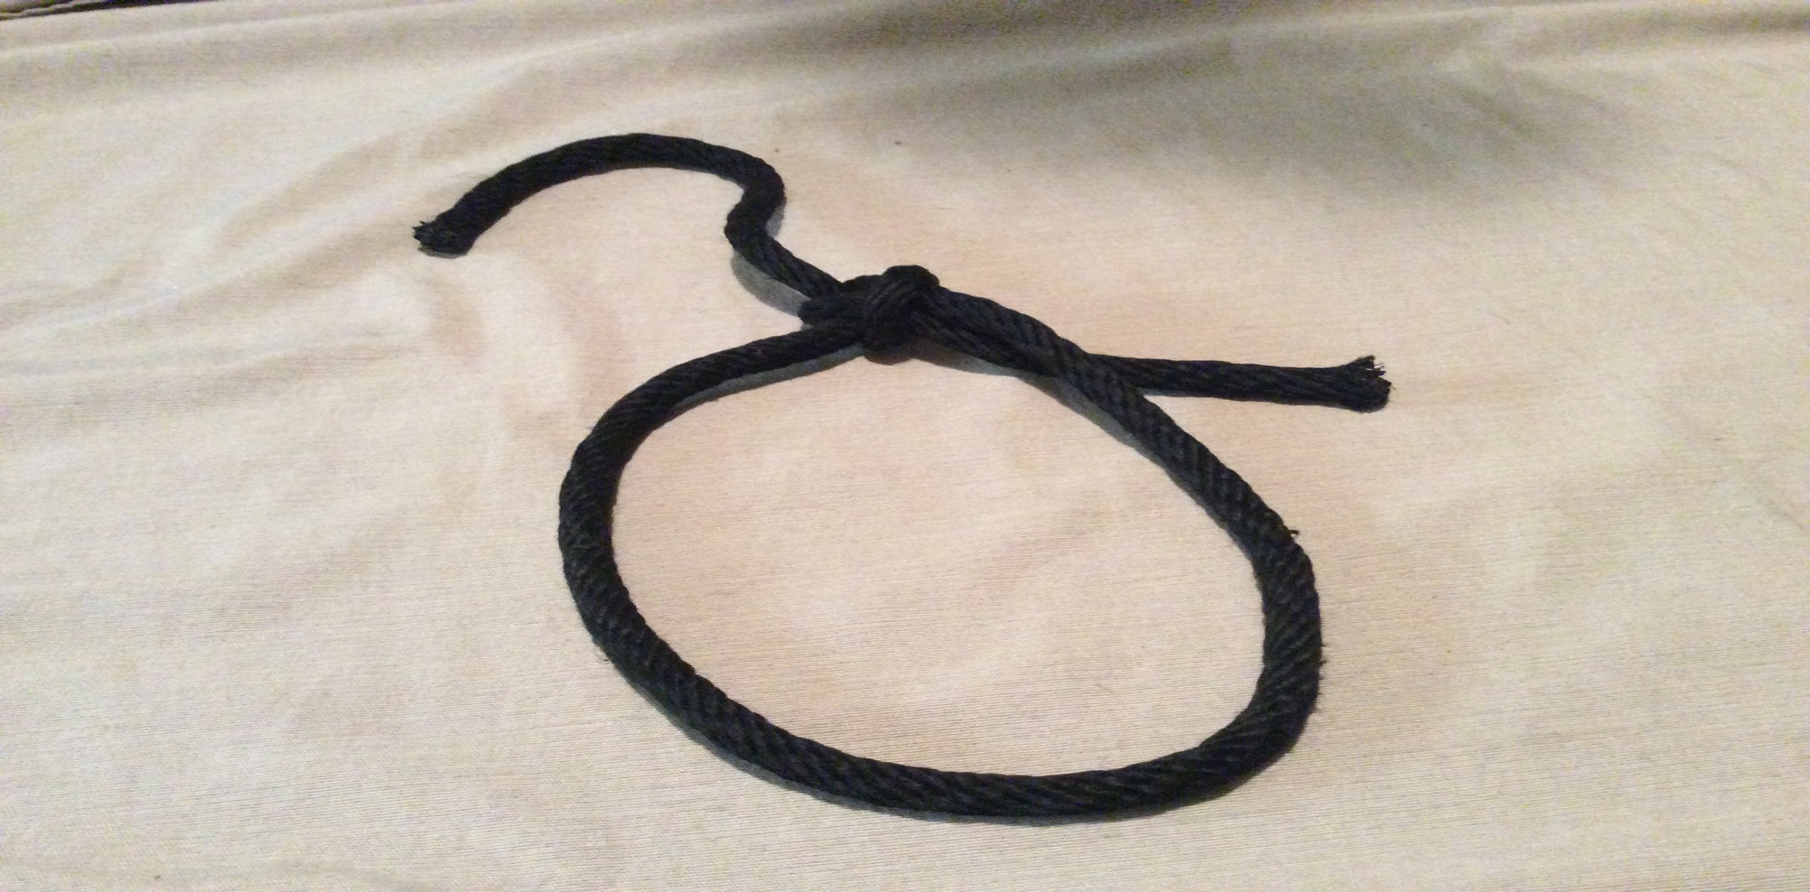
Step 6. pull both ends tightly

Slide 45
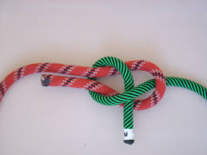
Sheet Bend

Slide 46
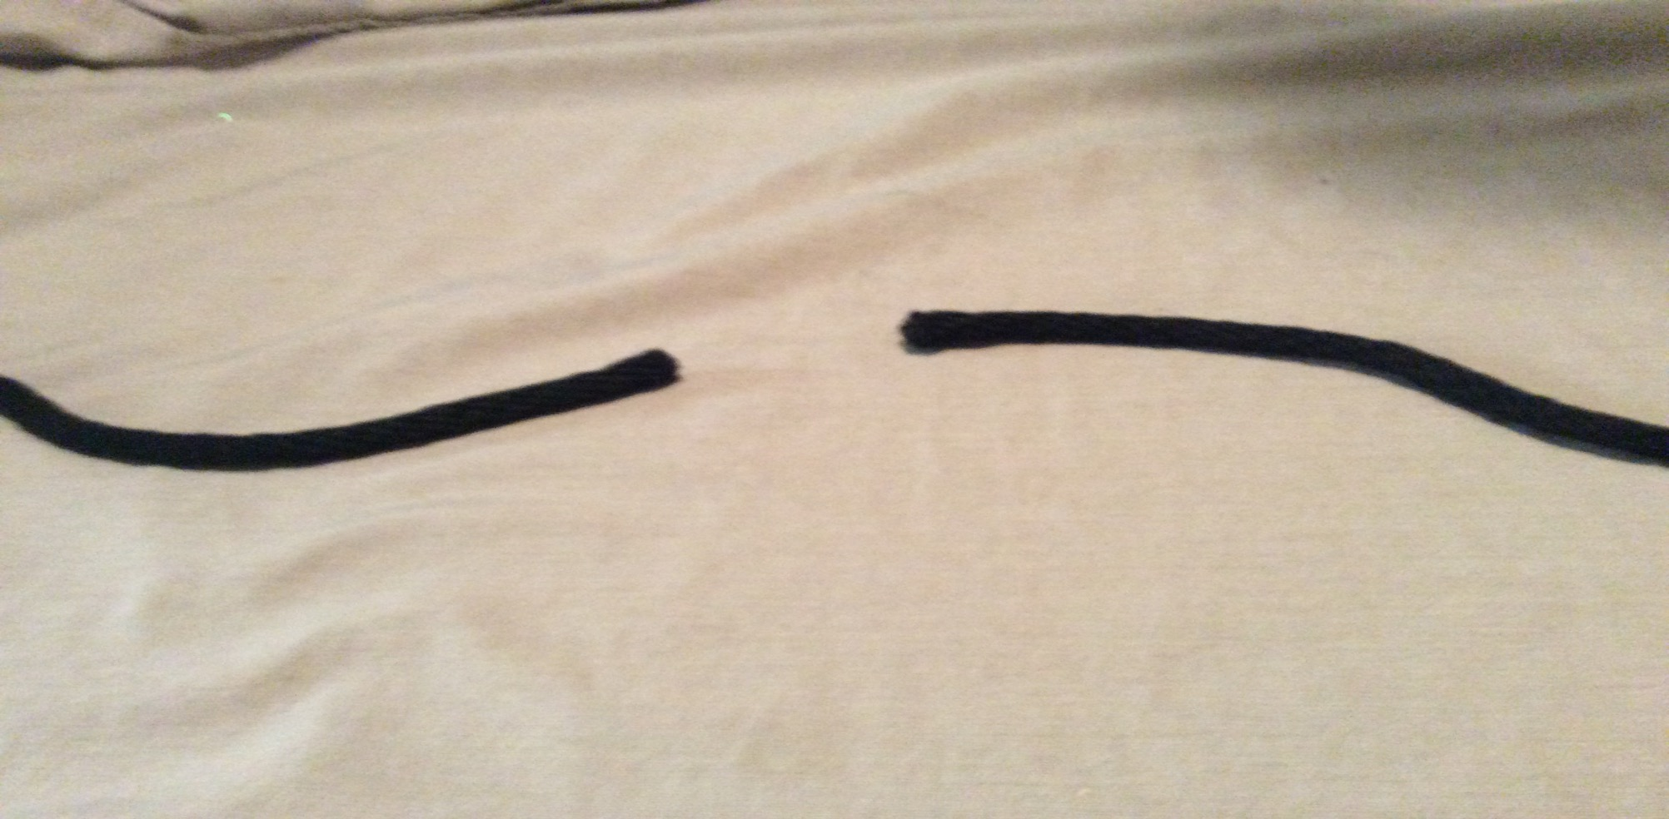
Step 1. lay the ropes across from each other

Slide 47
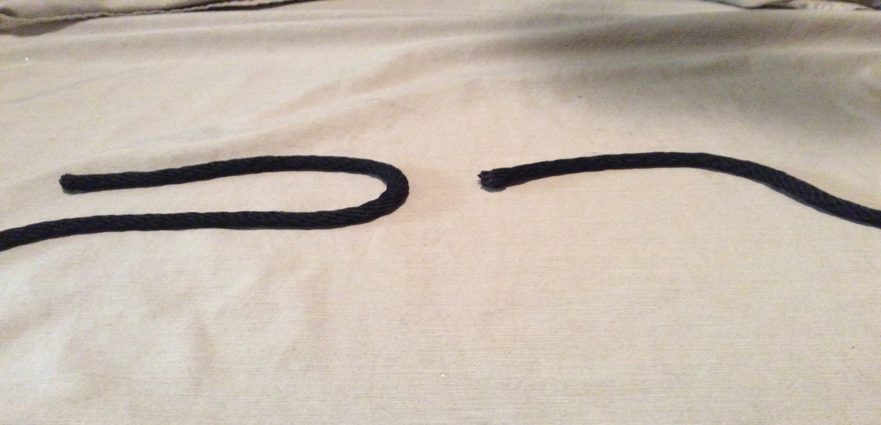
Step 2. bend back the left rope

Slide 48
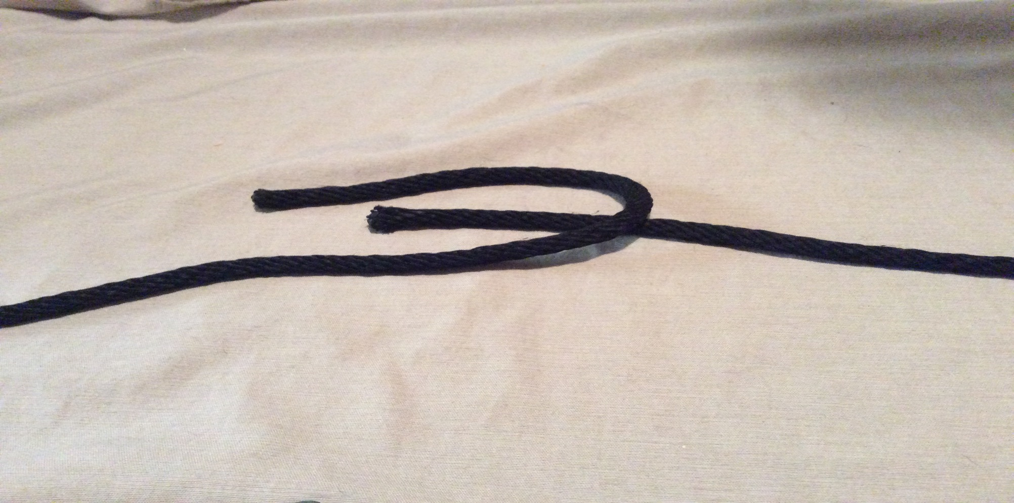
Step 3. put the right rope under the left rope bend

Slide 49
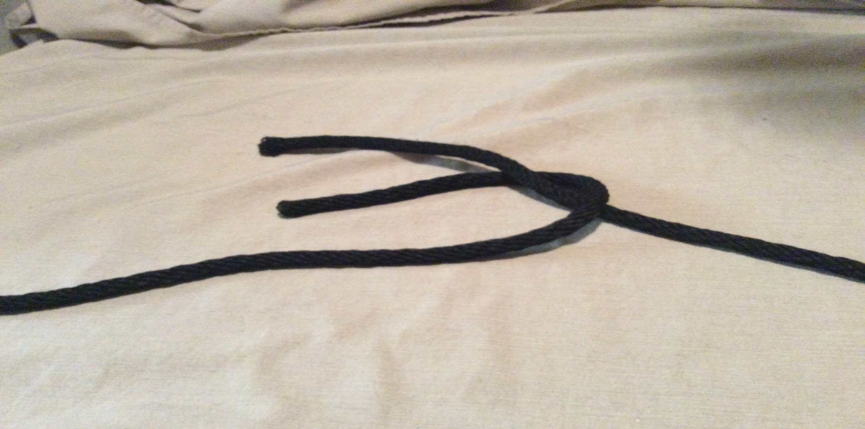
Step 4. bring the right rope over the left rope

Slide 50
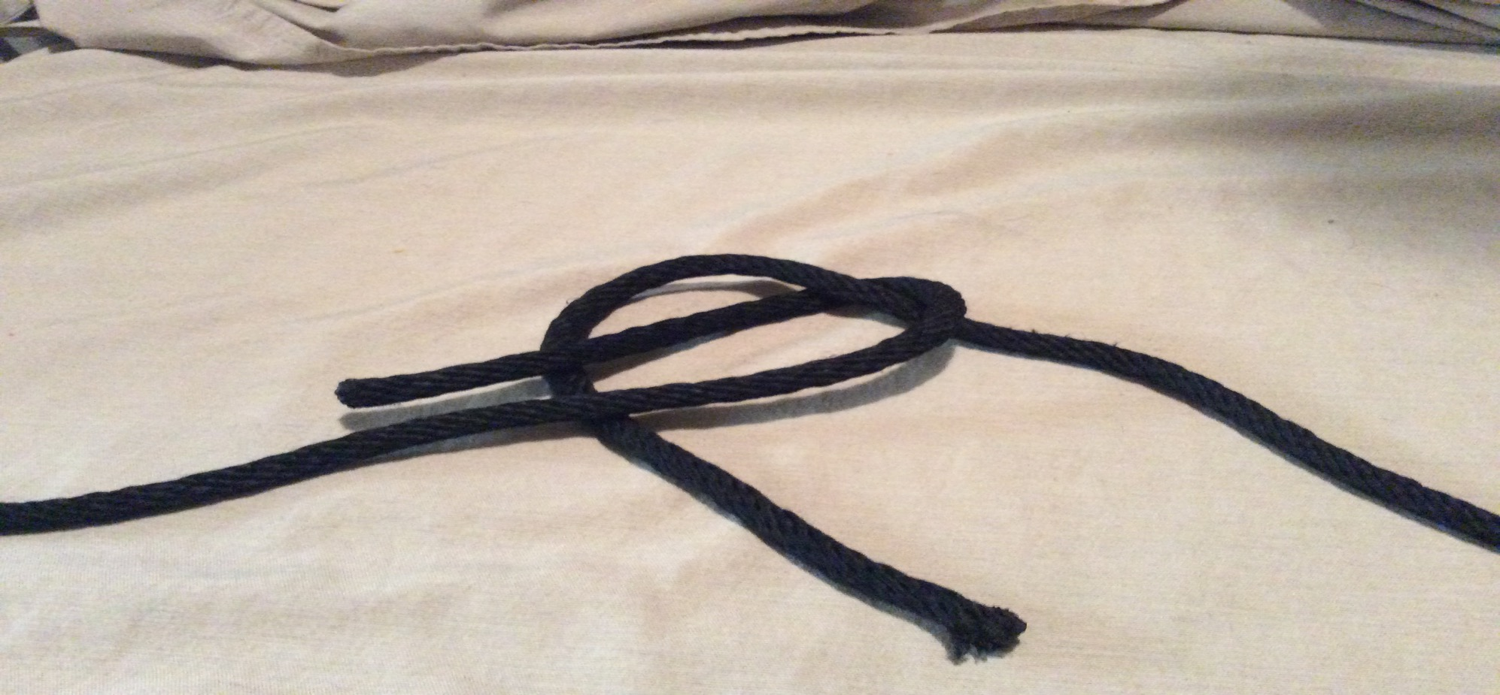
Step 5. bring the right rope under both of the left side ropes

Slide 51

Step 6. cross the right rope under the other side of its self

Slide 52

Step 7. pull all four ends tightly

Slide 53
That’s all Good luck(‘:’)

